Slide 1


Why Digital Content Marketing Matters for Channel Marketers

Slide 2

Content Marketing – A Holistic Approach
Most channel partners do not have marketing resources and, as a result, rarely use content marketing as part of their lead generation efforts. At most, they may have technical blogs or a social media program. But effective content marketing requires a holistic approach, and the best way to achieve this is with a Channel Marketing Automation platform that incorporates all the relevant content and integrated marketing tools for a complete campaign.
In situations of high demand and low competition, content marketing is not essential. The market will come to you as long as you are able to provide simple information distribution to prospects and customers. But for most areas of IT, this is how the world was fifty years ago.

Slide 3
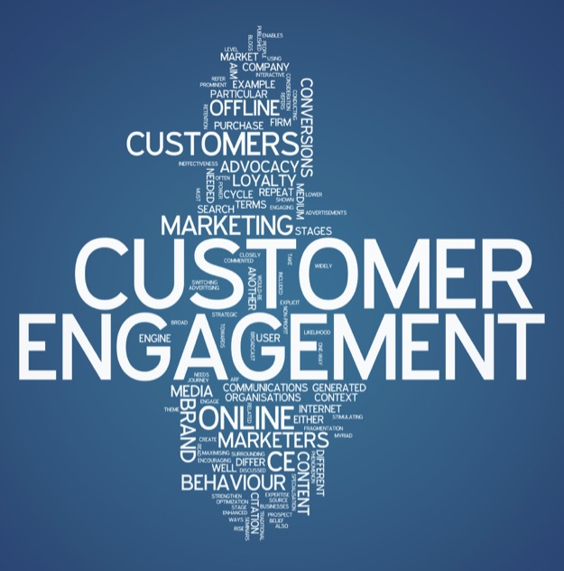
It’s All About Active Engagement
How things have changed! Most markets today are ardently contested by multiple providers. Unless you are a Google with 70% market share and a business model built around your monopoly as an information enabler, as a technology vendor you will need an active content marketing campaign if it is to grow and thrive. This means a lot more than just distributing information about products and services to existing customers or interested prospects. Content marketing is all about creating an active engagement that allows you to remain top of mind with potential buyers through a stream of valuable insights and information. Easy to say, but hard to do, since not only must compelling content be created, but you must also control content distribution and track its consumption.

Slide 4

New Era of Content Marketing
The good news is that over the past decade content marketing techniques have improved dramatically with digitization of content, and multiple methods of online distribution. As consumption of digital content has evolved into a three screens experience (mobile, desktop and TV), new content marketing – creation and tracking – tools have also emerged allowing the vendor/content provider to track consumption patterns, behavior and audience demographics with a high degree of precision.

Slide 5

Distribution of Content
Nevertheless, the challenge remains as to how you provide a content marketing platform within a channel marketing environment. Organizations that sell through a distribution network almost invariably find it difficult to provide content marketing tools that work efficiently as a channel marketing enabler. The key requirement to stimulate partner marketing efforts is for an integrated platform that distributors, resellers and IT solution providers can use without spending too much time or money.

Slide 6

The Solution Provider
At ZINFI we have dedicated ourselves for the last decade to solving this dilemma. Today, our Partner Relationship Management (PRM) platform provides a set of integrated channel marketing tools, including search, social, landing pages, events, web syndication, and more, that not only allows a vendor organization to provide digital marketing content to their channel partners, but also enables IT solution providers with no marketing expertise to get the attention of hundreds or thousands of buyers, using just a few clicks. Leveraging a complete set of integrated content marketing tools is is a completely revolutionary and highly successful approach in channel marketing today. More and more IT vendor customers are adopting ZINFI’s PRM platform as a way to enable their channel and drive ROI up substantially.

Slide 7
Thank You
North American Marketing Operations Center ZINFI Technologies, Inc. 6200 Stoneridge Mall Road, Suite 300 Pleasanton, CA 94588
1.866.707.1944 or sales.noram@zinfitech.com

