Slide 1
Automating Profitable Growth™
Must-Haves for Your Partner Portal
– Part 2 of 2

Slide 2
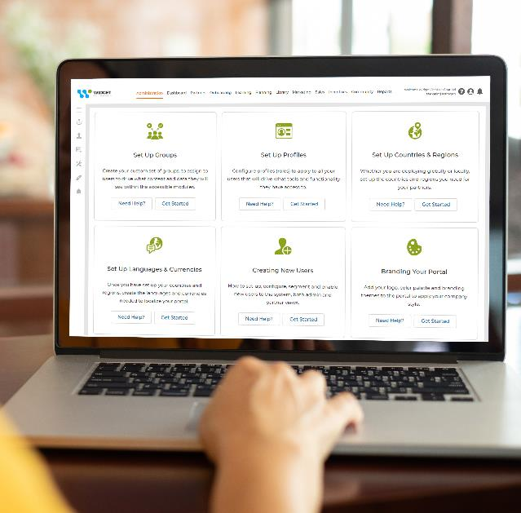
Must-Haves for Your Partner Portal – Part 2 of 2
In this hypercompetitive world, the ease-of-use of a vendor’s partner portal plays a huge role in portal utilization. The way in which content is uploaded and managed; responsiveness; user-friendliness of the interface; general accessibility: all have a substantial impact on the partner adoption process.
In the first part of this article we had discussed:
How Localized Experience for global companies could drive portal utilization.
How a Single-Sign-On (SSO) access to partner portal can make it easier for the partners to use the portal easily.
How a Unified Platform increases partner experience and adoption.
How a Mobile Responsive partner portals helps.

Slide 3
Must-Haves for Your Partner Portal – Part 2 of 2
The remaining key requirements of a perfect partner portal to improve partner adoption and usage are:
Search Optimized – If you are a vendor with multiple product lines and a large volume of vital content, making that content searchable is incredibly important. While the starting point is that sites need to be mobile responsive and have a unified access, the platform should also allow natural searches across various content categories, e.g., marketing, sales, products, technical, etc.

Slide 4
Must-Haves for Your Partner Portal – Part 2 of 2
Role Based – One of the surest ways to drive content access and utilization is follow the mantra ‘less is more’. How can you do that when you have a massive amount of content in your portal? You can substantially reduce it if you tag content by roles, so technical users get to see mostly product and technical related content, while marketing and sales folk tend to see content that is specific for them. If you have a good partner-profiling program in place, you should be able to determine which users should have specific type of content.

Slide 5
Must-Haves for Your Partner Portal – Part 2 of 2
Dynamic Content – Can you serve up portal content based on what your partners should see? Even if you have role-based access, you still need a platform that allows you to manage your content dynamically without spending a lot of resources. This is only possible when you have a dynamic content management system.

Slide 6
Must-Haves for Your Partner Portal – Part 2 of 2
Portal Training – No matter how localized, full featured and easy to use your platform is, in the end you still need to train your partners how to use your platform. This is a low hanging fruit, yet many vendors end up skipping this step. While there may be tons of content on product and programs, rarely is there enough content on how to use the partner portal. Spending a fraction of your channel budget by building training videos always drives up usage.

Slide 7
Must-Haves for Your Partner Portal – Part 2 of 2
Integrated Analytics – Once you have gone through all of these steps, the key is to stay alert to what’s going on in the channel and on the portal, and keep learning. This can only happen when you have embedded and integrated analytics that allow you to know what partners are using, what they are using on your portal, so that you can constantly update, modify and position content appropriately.

Slide 8
Must-Haves for Your Partner Portal – Part 2 of 2
We realize that this is a long list of must-haves, and it may be overwhelming for you and your organization to start implementing these changes. The good news, however, is that, there are options available that you can easily deploy step by step, to make these changes happen sequentially over an extended period. ZINFI’s Partner Relationship Management (PRM) and Partner Marketing Management (PMM) applications provide you a state of the art platform with solid performance records from dozens of localized deployments that can address your partner portal needs in a holistic way.

Slide 9
Automating Profitable Growth™

