Slide 1
Why a Lead Management System Is Critical for Channel Sales

Slide 2
Direct Distribution of Leads
Most vendors spend millions of dollars in generating end user awareness and inbound leads. However, very few have systems in place for getting those leads effectively to channel partners. Instead, many of those leads tend to be pursued by inside sales teams, but lack of an integrated channel lead management system substantially reduces marketing ROI.
At ZINFI, we regularly do channel partner satisfaction surveys and ask them how vendors can help them grow their businesses. The number one item on the list is distribution of good leads to partner sales reps. What we’ve found is that, even where leads are forwarded to top tier partners, very rarely do they have a structured system in place where leads are distributed, nurtured, qualified, tracked and closed. However, a good Channel Marketing Automation platform can significantly increase sales closures through a proper lead management system.

Slide 3
The Definition
Before we delve into this topic, let’s make sure we are clear what we mean by a lead management system. It is an automated, programmatic way of generating, allocating and tracking the performance of end user leads that have been provided to channel partners. Without an end-to-end automated platform, all this would be really hard to achieve. A state of the art lead management system should have a few core components:

Slide 4
1. Prospect Records Management
Since most lead management systems need to connect to a Customer Relationship Management (CRM) platform, it is essential that the prospect records management system is built upon a CRM-like structure. This greatly enhances data flow between the lead management system as well as other CRM platforms on the vendor or partner side.

Slide 5
2. Records Life Cycle Management
Once leads have been distributed to partner’s sales team, it should be possible to move the record through various sales cycles and track progress from stage to stage. Vendors should be able to log into the platform to check the progress of each record and the overall status of the pipeline. The partner should be able to record events like converting a prospect to a contact and adding opportunities to create a pipeline forecast.
3. Lead Distribution and Withdrawal
This is a critical feature for vendors, first of all to make sure a set of leads can be given to a set of partners, but also, if partners are not following up after a certain time, to be able to withdraw the leads back into the Prospect Records Management system for redistribution to other partners.

Slide 6
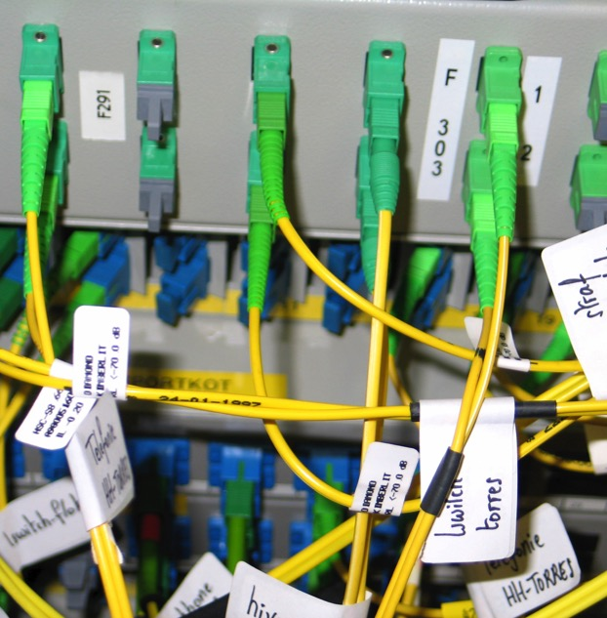
4. Lead Distribution Rule Set
A vendor should be able to push leads manually or automatically to a set of partners based on the lead type (SMB, Mid-Market, Enterprise, or other categorization) and also to match partner competencies, locations, and so on. This ability to create rule sets adds an important layer of automation to lead distribution, which gets the leads to partner team as soon as they are generated.
5. Account Protection
Certain end user accounts are managed by large or premier partners and a vendor may want to protect these accounts. The lead management system has to be able to protect one or multiple accounts and automatically push leads from those accounts to specific partners and sales people. On the other hand, if a vendor wants to have partners compete for certain accounts, they should be able to keep these leads as open records.

Slide 7
6. Rewards Integration
By integrating proper rewards and incentives, a vendor can greatly drive partner engagement and status reporting. We all know sales reps are busy and they have their own preferred CRM systems. However, a proper incentive structure around reporting can substantially enhance a vendor’s ability to track lead status, by using sales rewards to motivate individuals to enter lead status details into the platform – either manually or by automatic synchronization by connecting their CRM accounts to the lead management system.

Slide 8
7. Dynamic Reporting
A state of the art lead management system should be able to provide dynamic reporting to both partners and vendors, so that lead and pipeline status can be tracked at multiple levels. Since selling is a competitive sport, the ability to share stack ranking among individual partner reps also drives better participation and adoption of channel programs.
While such a long list of requirements may be daunting to anyone considering a lead management system, a robust Channel Marketing Automation platform such as ZINFI’s Partner Relationship Management (PRM) platform can not only facilitate lead distribution, but also substantially increase ROI.

Slide 9
Thank You
North American Marketing Operations Center ZINFI Technologies, Inc. 6200 Stoneridge Mall Road, Suite 300 Pleasanton, CA 94588
1.866.707.1944 or sales.noram@zinfitech.com

