Slide 1
Automating Profitable Growth™
Making Deal Registration Work
For Your Channel

Slide 2

Making Deal Registration Work For Your Channel
The concept
Deal registration is an incredibly important mechanism to not only eliminate channel conflicts but also reward channel partners to do the right things in the right way. Organizations selling through a channel can broaden their reach and increase their sales when they have the right channel programs in place, and deal registration can play a major role in that effort.
Any good deal registration program has three core objectives:
Deal protection – The foundation of channel partnership is based on the financial relationship and the competitive edge that relationship can provide to the partner. However, you could argue that the primary competitive edge a vendor can provide a partner is profitability. Therefore, by protecting a deal for a specific partner a vendor can ensure margin protection, along with other incentives the channel program may offer.
Customer satisfaction – Once a deal has been registered, it eliminates the opportunity for multiple channel partners to follow up with the prospect and therefore reduces the “annoyance factor” in selling. Also, the vendor can align sales support resources behind that specific partner in case the deal size is large and requires complex sales support.

Slide 3
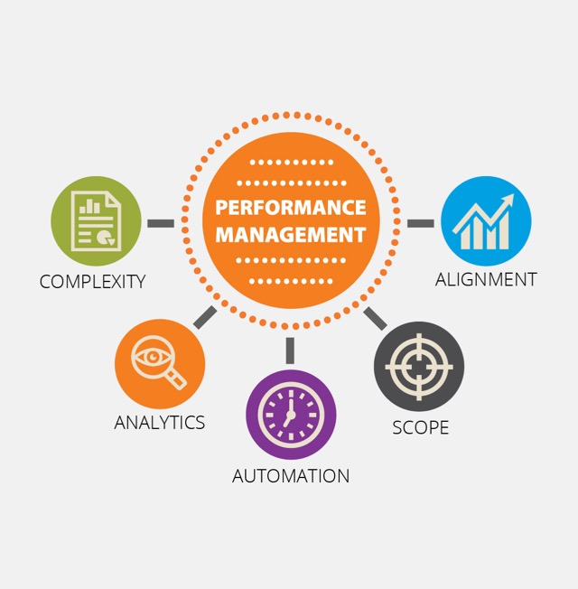
Making Deal Registration Work For Your Channel
Performance management – When a vendor aligns its other channel program components, deal registration not only brings in the benefits tied to deal protection and customer satisfaction, but can also provide an intrinsic set of incentives to the partner to sell more and scale faster.
With this context in mind, let’s look at some of the deal registration programs that are available today. In most cases, deal registration programs offer basic deal protection and margin enhancement. However, too often deal registration fails to become a strategic component of the channel program that enhances sales velocity and profitability because of the following reasons:
Complexity – The larger the organization, the more products it has to sell through the channel. With the proliferation of products, both the marketing and the sales teams end up repeatedly refining the program, and the program can quickly become highly complex. It is commonplace for the same program to have multiple variations across many countries despite the fact partners have already provided feedback that it is too complex.

Slide 4

Making Deal Registration Work For Your Channel
Scope – In most cases, vendors tend to protect mid-market and enterprise deals and keep SMB deals outside the deal registration program. This makes sense, except when the vendor may distribute SMB leads in an open environment to multiple partners using a lead management system. If this distribution is not properly managed, it can cause major channel conflict and customer dissatisfaction.
Alignment – It is crucial to make sure other components of partner programs – e.g., certification levels, rewards and rebates – are fully aligned with the basic scope of deal registration programs. Too many times, components of deal registration programs are changed, but not linked back to the broader channel program.
Automation – Lack of automation is a major issue with most channel partners. We consistently see across the channel that most organization tend to use a basic CRM platform to create their deal registration program, but lack of automated lead distribution and management not only creates confusion and frustration across the channel chain, but also ends up in the loss of opportunities to competitors.

Slide 5

Making Deal Registration Work For Your Channel
Analytics – Understanding what is impacting sales velocity and mix is critical to growing a deal registration program and making it more effective. Sometimes strategic inclusion – such as newly acquired product lines, an upgraded version of a platform, or a service offering that can be only sold through a set of certified partners – can significantly enhance the program. However, without an analytical tool that can slice and dice the data in multiple ways, deal registration programs will often remain a tactical tool and a black box.
If you are putting a deal registration program in place or reevaluating the one you have, the best place to start would be to ask these questions: Will it truly help your partners sell more with minimum channel conflict and friction? Will it maximize profitability from the transaction and align with other components of your channel programs? A simple, properly conceived deal registration program can go a long way to increase sales velocity, partner profitability and satisfaction.

Slide 6
Automating Profitable Growth™

