Slide 1
Most Important Features of a Channel Marketing Software Platform

Slide 2
How to Get Partners Engaged to Channel Programs
Many vendors today are deploying channel marketing software solutions to drive partner marketing activities. The goal for this class of software is to get partners actively engaged in various channel programs and enable them to drive demand generation activities. However, there are multiple options available in the market today from as many as 30 different vendors, which makes it very hard for an organization to determine the core set of features they should look for. This article will explore 10 critical features a channel marketing software platform must have.

Slide 3
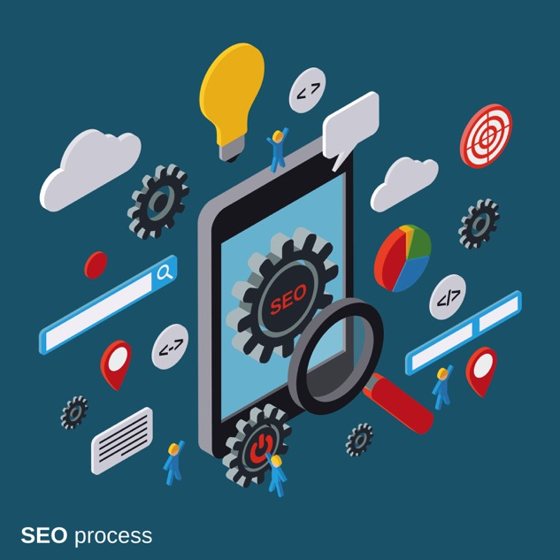
1. Portal Content Management
The goal for this capability is to allow an organization to set up a mobile-responsive, dynamic portal through which various assets and information can be communicated to partners that are in the channel program. Without a platform that can be completely localized across multiple countries and used in a mobile-responsive environment, the potential of a channel marketing software platform is rarely realized. It is perhaps the most important feature a organization must look for.

Slide 4
2. Campaign Upload and Setup
Once a dynamic portal has been set up, the next key area to focus on is the ability to upload campaign content that can allow the vendor to market to—as well as market through—their channel partners. Vendors considering an investment in a channel marketing software platform must ensure that any platform they evaluate has a dynamic content management system.
3. Single Sign-on
A vendor may already have an existing infrastructure in place to which a current or new portal may need to connect, either temporarily or in the long term. Because of that, it is extremely important to provide unified access and a seamless user experience. The channel marketing software platform must be able to connect to existing infrastructure via a single sign-on mechanism.

Slide 5
4. CRM Integration
Often an organization will have an existing enterprise resource planning (ERP) or customer relationship management (CRM) infrastructure in place, which could be based on Salesforce.com, NetSuite, Microsoft Dynamics, SAP or some other similar platform. The channel marketing software platform must be able to connect and integrate with any of these systems without a hitch. The data from the CRM system must be able to flow to the marketing software platform, and the activities being carried out by the channel partners must in turn be tracked and reported back to existing CRM infrastructure. Seamless integration at every step is absolutely essential.

Slide 6
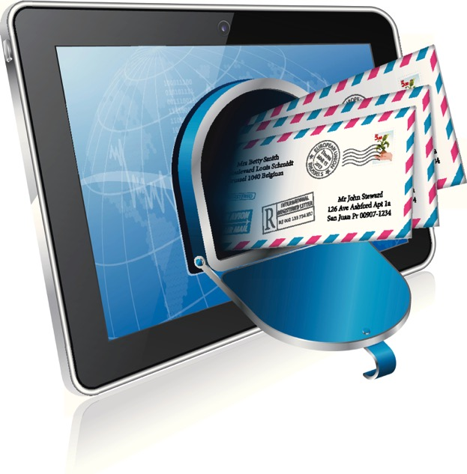
5. Email Marketing
When a vendor is trying to enable a group of partners with a set of channel marketing tools, one of the most important capabilities the channel marketing software must have is a multi-touch email marketing and nurturing feature. The email marketing engine should be configurable as a multi-touch tool, so when a prospect comes to a partner website and engages in some way, the system should be able to automatically send a follow-up email based specifically on the prospect’s activities. The email engine should also accommodate complete, dynamic co-branding capabilities so that a partner can easily edit existing content provided by the vendor and send out customized emails to prospects and the customer base in a few clicks.

Slide 7
6. Event Marketing
Most partners today—particularly those selling in the B2B area, but also those selling in the B2C marketplace — put on events to market products and services. They may be small events in a lunch-and-learn format, or they may take the form of much larger consumer events like award shows and ceremonies, where the entire event needs to be dynamically managed. In the latter case especially, the partner may end up using all the vendor’s campaign assets, but it can be difficult for the partner to co-brand that material and customize the launch and event, as well as manage it successfully in an integrated way. Good channel marketing software can do this, but the platform must be designed to provide a seamless, end-to-end event management capability whereby the partner can take the campaign assets provided by the vendor and easily co-brand them and manage a multi-touch event campaign.

Slide 8
7. Search and Social Marketing
With social media now proliferating through every phase of the customer engagement cycle, it is very important for vendors to provide their partners with social marketing capabilities. The channel marketing software platform must have those capabilities. In addition, the platform should also be able to connect to existing Google AdWords or other social media advertising mechanisms in which integrated search marketing campaigns can be carried out.
8. Rewards and Rebates
Even though this function is technically in the domain of partner relationship management (an area where unified channel management is also evolving), some basic tools for providing rewards and rebates through the channel marketing platform can be very helpful.

Slide 9
9. Content Syndication
The next most important feature for a channel marketing software platform is the capability for a vendor to provide content—whether it’s product showcasing, news, events, release announcements or blog content—into a continuous stream that the partner can syndicate content through their own website with a few clicks. The ability to provide meaningful content to partner websites allows the vendor to leverage a large network of partners and reach out to hundreds of thousands of end users, extending their the reach and their branding capabilities.

Slide 10
10. Deal Registration
The platform should also have a CRM capability that allows partners to upload their list, run campaigns using the platform’s campaign tools and tactics, convert a lead into an opportunity and register it as a deal, and then report it back to the vendor. We’ve already talked about how the channel marketing software platform needs to be able to connect to existing infrastructure both through single sign-on and through CRM integration. In that deployment configuration, the data from the partner account in the channel marketing software platform should be able to flow back seamlessly to the vendor’s existing CRM system.

Slide 11
Summary
As partner marketing has evolved over the last decade or so, and more vendors are consider providing channel marketing software to enable partners to effectively engage, increase awareness, and deploy successful campaigns and programs, it’s essential to make sure the channel marketing platform has a core set of features. Before you rush out to deploy, the best option would be to evaluate the top two or three vendors in this space, like ZINFI, and then perform a side-by-side analysis to determine exactly what each vendor can offer in each of these key areas.

Slide 12
Thank You
North American Marketing Operations Center ZINFI Technologies, Inc. 6200 Stoneridge Mall Road, Suite 300 Pleasanton, CA 94588
1.866.707.1944 or sales.noram@zinfitech.com

