Slide 1
Skyrocket Your B2B Lead Generation Results with Amazing Content and Social Media

Slide 2
Business Developers’ Primary Focus
What is the most important part of your job as a B2B marketer or business development professional in the tech space today? Generating leads! They are the lifeblood of your business model and the food that feeds your revenue pipeline. It’s a lot like a restaurant: Marketers get the public to take notice and walk through the front door, business development gets them to sit at the table and sales takes their order and serves them their dinner. But if the marketers can’t find potential customers with an appetite, there will be no sales.

Slide 3
It’s All About Lead
B2B lead generation is dependent on good digital marketing strategies. Inbound marketing has the staying power of unlimited presence and searchability on the web, whereas outbound marketing is usually time-restricted, expiring when the budgeted funds run out. That’s why you need a good strategy that helps you find the best prospects. If done right, your digital marketing can net you targeted audiences and response to conversion. Here are some tips to follow when deciding how to structure your B2B lead generation approaches:
Be a Social Media Wizard!
Social marketing can be a powerful tool, if done correctly and if platforms are chosen wisely….

Slide 4
1. Choose an Effective Social Platform
Social media is a sea of potential. There have been many studies done in the B2B space about the effectiveness of social media inB2B lead generation. Some reports proclaim excellent lead conversion on sites like Facebook and Twitter, and some warn against the waste of advertising dollars on these platforms due to non-targeted click-throughs and inflated analytics. The overwhelming consensus is that social media is an excellent medium for outreach, generating much discussion and brand awareness—but very few actionable leads. Out of all the social platforms, LinkedIn is far and away the best for B2B lead generation. It’s the site where you should focus your digital marketing efforts. Although there is plenty of casual social chatter and personal posting bubbling up on LinkedIn these days, it has remained very focused on B2B connections and communications. The percentage of external non-business content represents only a small fraction of the cat pictures and infernal “I’m at Starbucks!” selfies on Twitter and Facebook. LinkedIn remains a viable source of genuine lead-generation potential. Two tips to using it correctly:

Slide 5
Be Active
Once you establish a presence on LinkedIn (whether through your personal profile as a thought leader or through your company page) remain active and engaging. Post articles to Pulse, share articles written by others that you find relevant and can tie back to your own content, and comment on related postings and articles. Engage in conversation. Make sure you don’t let several days or weeks go by without making some kind of a mark. Inconsistency will only cause you to be overshadowed and pushed down the page by those who post regular writings and commentary.

Slide 6
Join Groups
The best, and quickest, way to find a target audience is to research and join discussion groups that are formed around central topics pertinent to the content you are creating and sharing. This puts you in a more intimate space of communication and engagement, and can be an excellent form of B2B lead generation by attracting interest from a) potential prospects or b) influencers whose ear you might catch and who can help get you additional attention by commenting on your behalf.

Slide 7
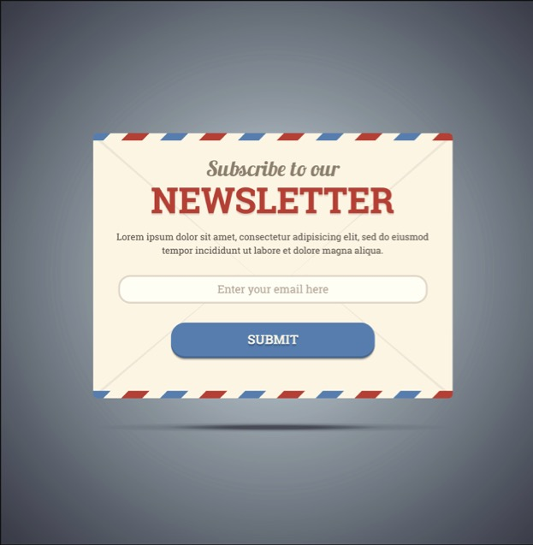
2. Allow Newsletter Signups via Your Social Media Presence
Newsletters have always been an effective method of B2B lead generation, but finding engaged subscribers has been a bit of a struggle. Why add scraped contacts from database queries and add them “cold” to your newsletter distribution when you can have “warm” recipients actively opt in via social media registrations and collect leads that are ready to talk to you?

Slide 8
3. Distribute Video Content As Tech Talks
YouTube, with over 1 billion viewers, is a heavy hitter in video distribution, and many businesses have created channels of thought leadership video media to convert viewers to their websites. The problem is that the YouTube platform has become noisy—diluted by skateboarding antics and top ten lists of who is more famous than whom. I urge you to explore Vimeo (170 million viewers, a fifth of the audience of YouTube), which has a much higher percentage of business-minded viewers and more of a collaborative audience who view Vimeo as a thought leadership syndication platform. B2B lead generation is likely to be much more effective on Vimeo. The channel categories remain cleaner and content is more focused on in-depth tech talks and industry dialoguing.

Slide 9
4. Funnel Back to Your Website
Of utmost importance in your B2B lead generation strategy is to remember that every bit of syndicate content you push out through any of these social channels and platforms must have links and references to drive people back to your website. The social media presence you create will not generate your leads alone, they will only stir up interest—it is your website that is the final destination to convert leads and be your best salesperson. Make sure that everything out there generates interest and funnels people back to the site as the great closer!

Slide 10
5. Publish Surveys And Research Reports
Take” the Lead: Tips for Attractive Content Marketing
Properly presented content will be your best weapon in conquering the B2B lead generation castle by storm….
EBooks are great, although many marketers are opting to call them “handbooks” or “guides” to avoid confusion with paid eBooks on sites like Amazon, and blog articles are informative and fantastic for SEO placement. However, nothing packs a value punch like putting out a survey or report. These are the best vehicles for thought leadership, as they are generated from facts-based data and actionable metrics rather than opinions or conjecture on the part of the author.

Slide 11
6. Provide Educational or Resource-rich Content
Make sure all your content —whether blog articles, videos or PowerPoint decks via SlideShare—is positioned to speak on trending topics, pain points and issues relevant to your target industry. Instead of serving up diatribe, be educational and deliver solutions. The more value you add in becoming a resource in your content area, the more your B2B lead generation conduit will open up to prospects who see your product as a solution and want to review your site for more information.

Slide 12
7. Stay Visual When You Can
As great as eBooks, reports, white papers and the like are, and as informative as they can be, nothing captures attention like an effective visual. Why put out a dry white paper chock full of charts and percentages when you can create a fun infographic? Why include a lined chart of numbers in your PowerPoint deck when you can create an iconographic representation? Pictures paint a thousand words, and people will respond to them more readily. Pictures are immediately and easily absorbable, whereas pages of text take too long to digest. Sell to the fast food culture we live in and watch your B2B lead generation efforts yield more prospects!

Slide 13
Hitting the Right Notes
When it comes to B2B lead generation, remember to stay alive, stay relevant, stay focused, chose the right channels and let your solutions be seen with compelling visual imagery. By putting the right message in front of the right people in the right way, you can capture much more effective traffic. I would rather have 10 genuine hot leads visit my site every day than 1,000 looky-loos who have wandered in through some vague digital marketing pitch. B2B lead generation that is about speaking to targeted industry audiences—in small, interesting ways—is much more powerful than spreading a message across the universe that falls on mostly deaf ears.

Slide 14
Thank You
North American Marketing Operations Center ZINFI Technologies, Inc. 6200 Stoneridge Mall Road, Suite 300 Pleasanton, CA 94588
1.866.707.1944 or sales.noram@zinfitech.com

