Slide 1
Automating Profitable Growth™
10 Keys To Launching Successful
Outbound Marketing Campaigns

Slide 2

10 Keys To Launching Successful Outbound Marketing Campaigns
To be effective at outbound marketing, one must first have a clear understanding of what it actually means. Outbound marketing by definition refers to paid advertising and media services. That sounds simple enough, but outbound marketing is complex, in part because it rarely exists in a vacuum. It is important to understand the complex relationships and interdependencies between paid (outbound), owned (inbound) and earned media before launching any campaign.
Very rarely can outbound marketing work as a standalone campaign. Most companies will start with a tight budget and will start by creating basic sales collateral and spreading it as far as they possibly can in any given effort. Outbound marketing is used most often as a way to pick up and move this effort forward. It can be an effective way to tap into new target audiences, but is not a magic trick in and of itself. While outbound marketing is absolutely helpful in acquiring new prospects, the closure of a sale will typically require supporting inbound material.

Slide 3

10 Keys To Launching Successful Outbound Marketing Campaigns
Here are some tips to keep in mind as you fine-tune your outbound marketing tactics:
Prospects consider action when they hear a message more than three times. In general, as a rule, humans like things that are familiar and that they can predict. That is why “branding” exists. Hearing the same message more than once in outbound marketing is helpful for memory, but it can so be helpful just for awareness. One of the biggest mistakes in marketing is to pull out of a campaign too soon. When repeating similar messages, always make sure that you give each message a fair amount of time before you decide whether or not it is resonating with your audience.

Slide 4

10 Keys To Launching Successful Outbound Marketing Campaigns
You need to reach the same prospect in more than one channel. Gone are the days where we have the luxury of communicating only one way with our prospects. As keen marketers we need to remember that our prospects are being bombarded with advertisements across multiple channels. If your company is not there, you can pretty much bet that your competition is. Great outbound marketers understand that their prospects will absorb information differently and need to hear it more than one way. In an ideal world, a prospect will both hear AND see a message multiple times.

Slide 5

10 Keys To Launching Successful Outbound Marketing Campaigns
Go digital for at least one campaign. Whether you like it or not, websites and integrated digital marketing are here to stay. Websites are becoming “online brochures” and are often the first point of contact for a prospect. But that’s only the beginning. Digital marketing is incredibly cost-effective when done right (particularly since you do not pay heavy print or production fees). Furthermore, it can also provide valuable feedback. Unlike other paid forms of outbound marketing, digital marketing automatically has the ability to generate analytics.

Slide 6

10 Keys To Launching Successful Outbound Marketing Campaigns
Add a human touch. With all of the advice about going digital for one campaign, one of the biggest drawbacks is that paid outbound marketing is one-way communication. In a day where there is a strong trend toward increasing conversations with customers in communities online, a great outbound campaign needs to entertain, connect or educate a potential buyer.

Slide 7

10 Keys To Launching Successful Outbound Marketing Campaigns
Master tight campaigns in fewer channels. A great outbound marketer knows that you can’t be everywhere at once without losing the ability to tightly manage your campaigns. While you absolutely should market in more than one channel, one of the tricks to learn for each channel is to keep your campaign tight. Run campaigns only at certain times of the day, use only specified words or messaging and target a specific audience repeatedly until you have a fair assessment period to measure success. Outbound marketing that is not done well creates a very wide net and loosely targeted audience. Outbound marketing that is done well creates a very specific message to a very specific audience and incorporates insights from performance metrics to get better results.

Slide 8

10 Keys To Launching Successful Outbound Marketing Campaigns
Create a very clear call to action (CTA) driving the audience to a single place. One of the biggest mistakes made in outbound marketing is with the CTA. Time and time again marketers make the mistake of not driving traffic to a specific location, not making the call to action prominent, and confusing the audience about what they should do or where they should go. For example, do you want the prospect to visit your website or call a sales agent? Being absolutely clear can be the difference between a successful campaign ROI and a failure.

Slide 9

10 Keys To Launching Successful Outbound Marketing Campaigns
Emphasize speed, quality or price. In essence, know your selling points and emphasize your primary value proposition. One of the main differentiators of a product or service will almost always come down to being faster, better or less expensive than a competitor. While everyone tends to want to be “all of the above,” you need to clearly emphasize one selling point as your priority.

Slide 10

10 Keys To Launching Successful Outbound Marketing Campaigns
Standing out is a good thing. For outbound marketers, the expression “any press is good press” holds true. The goal of a great outbound marketing campaign is to have it take on a life of its own. While you don’t want to come across in a negative light, you certainly do want to stand out in some way. Do not be afraid to entertain your audience and pop out from other advertisements. Using an unlikely model or spokesperson, veering away from canned production voices on air or gently “breaking the rules” can all be good Let’s face it, consumers are flooded with advertisements. How can you get yours heard?

Slide 11

10 Keys To Launching Successful Outbound Marketing Campaigns
Emphasize timing and incentivize. Okay, so you have picked channels for your outbound marketing campaign and you have honed in on a target market and maybe even selected your desired time slot for your campaign. Now think hard: What is going to get your prospect to pick up the phone today? While you may want to offer a monetary incentive (this is quite common in outbound marketing in the form of discounts or promotions) you can also reference current events. Outbound marketing is all about being in front of the right audience, with the right message, at the right time. “Why now?” is one of the most critical questions your campaign needs to answer.

Slide 12
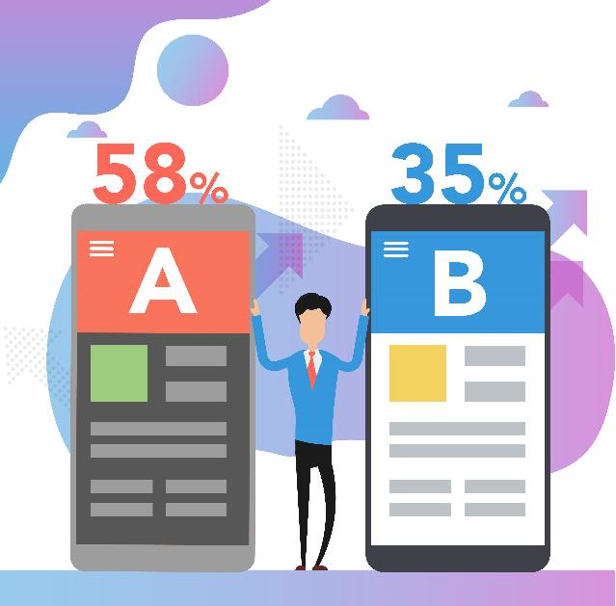
10 Keys To Launching Successful Outbound Marketing Campaigns
Run A/B split testing. Marketing 101 says that you should always test your messaging and see which one yields results. Creating two separate messages and testing them in similar demographics can help you answer a very valuable question: “What message resonates with my audience?” Taking the time to adapt your messages based on feedback from analytics or customer responses can absolutely help propel your outbound marketing campaign to success.
For more marketing tips and best practices, information about marketing automation, or demand generation please visit us a www.zinfi.com

Slide 13
Automating Profitable Growth™

