Slide 1
3 Tactics Your Channel Marketing
Software Must Support

Slide 2
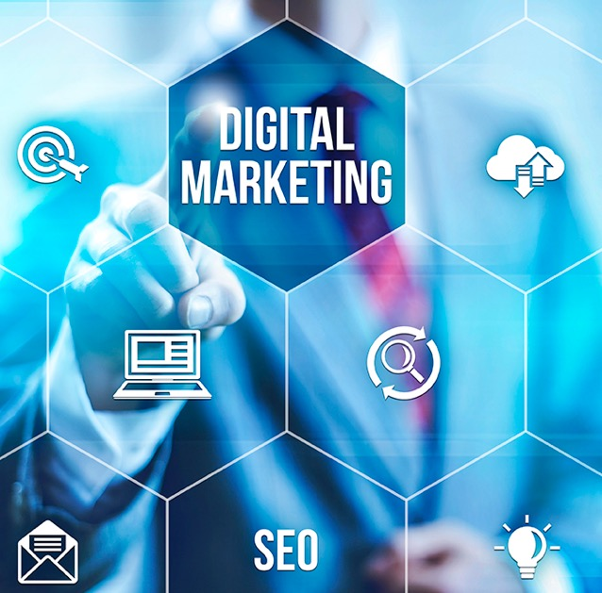
3 Tactics Your Channel Marketing Software Must Support
Many organizations selling through the channel today are considering deployment of channel marketing software. This is a great move. It can provide brand consistency across the partner base, introduce digital marketing tools to partners who don’t have access to such tools, and enable rapid roll-out of multi-tactic campaigns across multiple markets.
However, for channel marketing software to be successful, it needs to have three core capabilities that enable three core tactics. In this article, we will explore those capabilities.
First, any channel marketing software should have a solid multi-touch email engine that allows a vendor to load a variety of email templates with campaigns linked to landing pages. The email engine needs to be robust. It must have anti-spam scoring capabilities, and should also ensure a high delivery rate. Most channel marketing software vendors really do not address these issues during their sales demo, so if you are considering any channel marketing software, please make sure that the email engine and infrastructure is state-of-the-art and robust.

Slide 3
3 Tactics Your Channel Marketing Software Must Support
Second, state-of-the-art channel marketing software must have a very robust event engine. In today’s world of virtual and digital marketing, face-to-face events are becoming rare or highly specialized. Virtual webinars and events have surpassed traditional meet-and-greet types of events for basic information sharing. People are busy today, and most would rather download a webinar and watch it offline than drive several few hours to attend an event where they may learn only one or two things. That’s why your channel marketing software should provide both physical and virtual event management capabilities, and accommodate complete RSVP and logistics management.
Third, in addition to outbound tactics like email or event, your channel marketing software must provide a highly robust inbound marketing engine tied to search marketing and social marketing. You should be able use search marketing to advertise via online paid search programs like Google and Facebook, and you should be able to use social syndication to drive inbound traffic. We will not discuss these two outbound tactics in more detail here, but in order for your partner base to truly benefit from your channel marketing software, it must have robust search and social syndication capabilities.

Slide 4
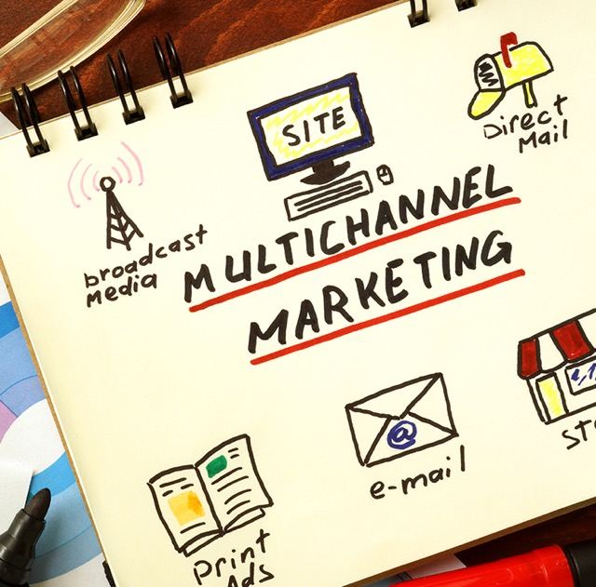
3 Tactics Your Channel Marketing Software Must Support
These three core capabilities aren’t optional; you shouldn’t consider any channel marketing software vendor that cannot fulfill these requirements. However, if I were to select one additional capability to consider for your channel marketing software, it would be co-branding capabilities for your collateral and other assets. Such assets can include data sheets, product literature, case studies, success stories, banners, posters – you name it. These assets can be for digital use only, or you may want your partners to be able download and print them. Only state-of-the-art partner marketing automation platforms like ZINFI’s come with such advanced collateral management capabilities where your partners can not only edit and co-brand assets, but also download them for high-quality printing.

Slide 5
3 Tactics Your Channel Marketing Software Must Support
I hope this article gives you an overview of some of the core features you must consider when evaluating channel marketing software. While the features I focus on here are particularly important from the partner perspective, it’s also crucial from the vendor perspective to have access to a robust content management system that allows you to set up campaigns by uploading assets and building campaign logic, just as you can do with direct marketing automation tools.
All of these capabilities are available in the marketplace in different forms, but very few vendors can provide all of these under a single unified channel management framework like ZINFI’s. This is why our solution is gaining so much traction and displacing existing vendors. We put the power of digital marketing not just in your hands, but in the hands of thousands of partners across dozens of Fortune 1000 companies around the world. What a great time to be in this market – the fun is just beginning.

