Slide 1
Automating Profitable Growth™
Three Core Focus Areas for
Channel Marketing

Slide 2
Three Core Focus Areas for Channel Marketing
Channel marketing involves a broad range of activities. While these activities tend to vary from one company to another, there are three core focus areas that are consistent across most companies. These are
marketing to partners
ii) marketing through partners and
iii) marketing with partners. In this article, we will explore the general nature of these three categories of activities.

Slide 3
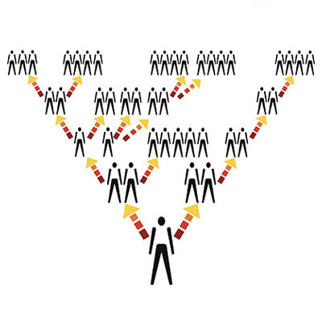
Three Core Focus Areas for Channel Marketing
1. “Marketing to” partners
The purpose of a sales channel is to provide an indirect sales motion, but due to the nature of this indirect relationship it is essential for a vendor selling via a network of partners to keep those partners informed about what is going on with the organization and how the partners can engage better to sell more and earn more.
Typically, “market to” activities involve promoting the availability of new products, programs and promotions. They also involve various aspects of product and services training, as well as multiple levels of detail related to sales activities, initiatives and channel marketing programs.
The primary purpose of “marketing to” activities is to ensure that partners are informed of all aspects of the vendor’s channel marketing programs so they can drive revenue generation forward.

Slide 4
Three Core Focus Areas for Channel Marketing
2. “Marketing through” partners
The core set of activities involved in this channel marketing area is primarily about making end buyers aware of a vendor’s products and services, and any changes associated with them. This may involve the launch of a new product, special pricing, bundling of products and solutions, or an end-of-life designation or withdrawal of certain product categories.
For an organization to achieve a run rate in their channel sales, it is essential to have a structured set of channel marketing programs that reach end buyers via the channel partner network. This can be achieved by aligning various channel marketing programs that are delivered via an automated channel marketing management capability. ZINFI’s partner marketing management (PMM) automation platform is designed to deliver such programs in an optimally cost-effective and efficient way.
The amount of partner content or branding involved in “marketing through” activities tends to be limited, and most program details and activities tend to come from the vendor. Primary examples of such channel marketing programs are typically seen in franchise or fully captive channel sales models.

Slide 5
Three Core Focus Areas for Channel Marketing
3. “Marketing with” partners
The primary focus of these channel marketing activities is on co-marketing. Many channel organizations provide market development or co-op marketing funds. Such funds are essential to put together end-user training as well as awareness and sales programs.
In almost in all cases, these programs incorporate some level of partner branding and content. The entire focus of “marketing with” channel marketing activities tends to be on promoting the partner brand in conjunction with the vendor brand. In the case of technology solutions or technology alliance campaigns, this might involve running co-branded advertising (“powered by XYZ!”) campaigns.
The level of partner content and branding involved in “marketing with” activities tends to be quite significant, and multiple brands tend to be equally represented. As I mentioned earlier, multi-brand alliance marketing tends to be a primary focus of these types of channel marketing activities.

Slide 6
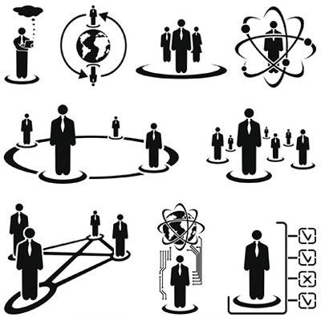
Three Core Focus Areas for Channel Marketing
In addition to these three primary focus areas, there are various other types of channel marketing activities that a vendor organization can carry out, often related to financial and regulatory aspects of the business. Some examples of these would be activities focused on various trade groups, such as medical associations or agricultural associations. We will explore those examples in a separate article.

Slide 7
Automating Profitable Growth™

