Slide 1
Automating Profitable Growth™
Why Multi-Touch End User Marketing
Doesn’t Work In Channel Marketing

Slide 2

Why Multi-Touch End User Marketing Doesn’t Work In Channel Marketing
Channel marketing has finally begun to emerge from the dark ages and deploy digital marketing tools. While most end-user marketing today is driven by persona-based or account-based marketing that leverages various forms of digital assets, channel marketing still tends to use a patchwork of direct marketing tools and tactics that really don’t work very well in driving demand via the channel. One such area of failure is when channel marketing professionals deploy a direct marketing tactic like multi-touch marketing that goes beyond a few touches. Why is that? That’s what we will explore in this article.
Over the past decade, marketers have spent enormous amounts of time and money figuring out how to align their activities and tactics with the buyer’s journey. Now, at last, some of these tactics are being applied to channel marketing, but in most cases they don’t work. To better understand why, let’s step back for a second and examine the alignment of marketing and sales activities with buying activities.

Slide 3
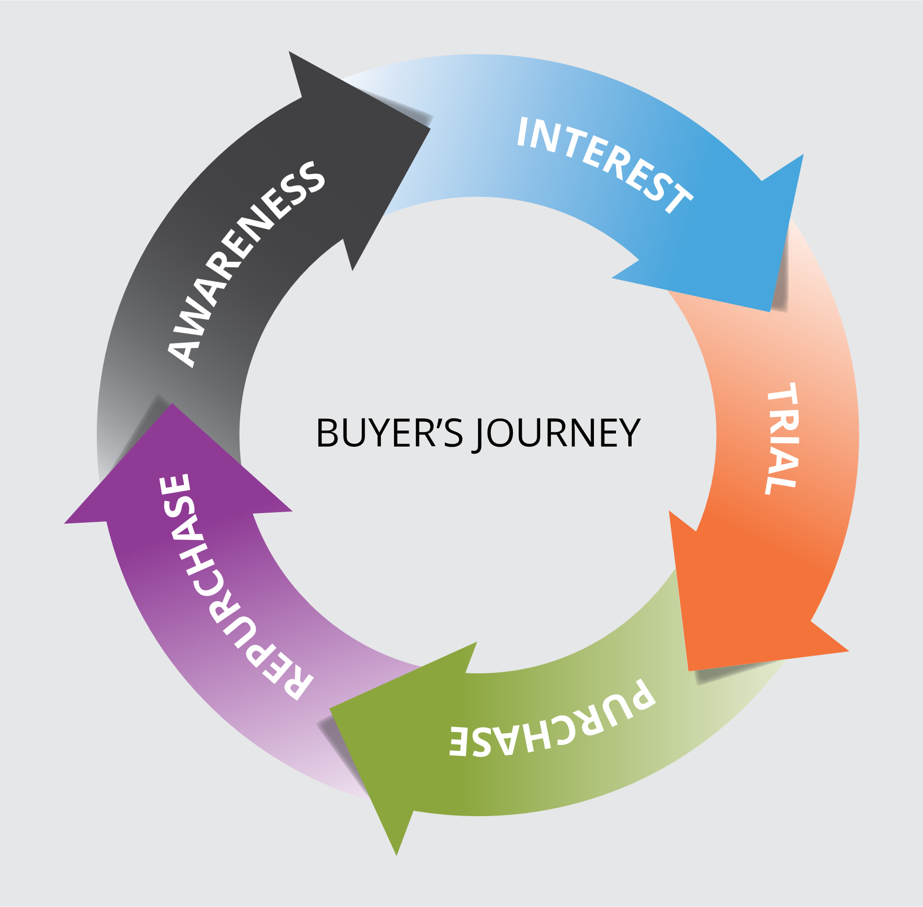
Why Multi-Touch End User Marketing Doesn’t Work In Channel Marketing
A typical buyer’s journey comprises awareness, interest, trial, purchase and a repurchase cycle. Marketing tends to be involved in the awareness, interest and trial phases, while sales engages from the trial phase onwards. However, buying behavior changes quite dramatically when you shift the focus from consumers to businesses, and when you consider how marketing and sales professionals engage in the buying journey.
For example, in the case of large businesses, multiple people may be involved in a purchase decision, whereas in the case of smaller businesses it’s more common for the owner or perhaps a couple of people to decide. The individuals who together make a decision to buy are typically referred to as a “buying unit.” In the case of a consumer household, the buying unit may consist of Mom, Dad and Child, particularly when it comes to a major purchase of, say, an automobile or a house, and it is likely just Mom or Dad when it comes to purchases of smaller-ticket items. A similar dynamic exists within businesses. Small-ticket items may be decided by one individual, while larger, more complex investments are decided by a committee.

Slide 4

Why Multi-Touch End User Marketing Doesn’t Work In Channel Marketing
This distinction is a source of considerable complexity in much marketing, and especially in channel marketing. Today, organizations that are selling through a channel but primarily targeting end users tend to carry out most marketing activities digitally while still incorporating traditional media like print, radio, TV and billboards. With the rapid digitization of analog touchpoints like radio, TV and billboards, most tactics are executed within an integrated digital platform, allowing marketers to track and measure in great detail what works and doesn’t work. When digital marketing identifies activities that do not work, marketers can refine and evolve their tactics rapidly.
With the availability of these digital capabilities, multi-touch marketing has evolved as a primary tool for moving buyers from one phase of their journey to another. For example, it can create awareness campaigns via Facebook or other social media advertising, drive prospects to a landing page with a video of a product use cases or celebrity endorsements, and entice them with a coupon to create a sense of urgency and drive prospects to complete the transaction. This is a very typical multi-touch tactic that can be refined rapidly via variations in content, positioning and offer combinations to produce significant ROI.

Slide 5

Why Multi-Touch End User Marketing Doesn’t Work In Channel Marketing
However, this approach completely fails in the channel marketing framework. There are several reasons multi-touch tactics fail in the channel marketing environment, but the predominant reasons are as follows:
Most channel partners do not have the marketing processes and people in place to effectively drive digital marketing. As vendors struggle to scale their initiatives globally under constant time and budget pressures, false hopes emerge that somehow partners will engage with a “cool” campaign and drive successful multi-touch programs. It does happen occasionally, but randomness is never an answer for continuous and sustainable success in channel marketing. Because they typically lack appropriate processes and people, most partners simply do not engage with multi-touch campaigns.
Multi-brand channel partners also lack the ability to focus on a specific brand for generating revenue—until and unless that specific partner has a dedicated marketing and sales resources behind the vendor brand. Even in that case, improper or inadequate sales and marketing training tend to get in the way of effective channel marketing.
This begs the question: Should vendors selling through the channel completely abandon multi-touch campaigns? The answer is “maybe.”

Slide 6

Why Multi-Touch End User Marketing Doesn’t Work In Channel Marketing
Think of it this way: A marketer picking a tactic is a lot like a soldier picking her weapon in the battlefield. The wrong tactic will get you killed. The most important place to start is to consider the type of solution you are offering. If the offer is transactional, then a transactional tactic like search, social or email—i.e., single- or two-touch tactics—are the most likely to work. If the offer is a solution and requires a long buying cycle, then a multi-touch approach would be required. However, that approach would still need to be delivered differently via the channel.
In the case of one- or two-touch campaigns, the campaign lifecycle tends to be short and can be leveraged by partners with limited time and resources. However, for a complex solution involving a long buying cycle with multi-touch components lasting over several months, the campaign must be run by the vendor directly or by using a channel marketing concierge service that can nurture the leads and hand over near-qualified prospects to the partner sales reps to pursue.
Most vendors fail to differentiate between these two approaches and mix up tactics, thereby wasting enormous amounts of marketing resources, frustrating the partner base and setting false expectations with the channel management team.

Slide 7

Why Multi-Touch End User Marketing Doesn’t Work In Channel Marketing
This isn’t the place for me to undertake a detailed analysis about how to make channel marketing successful in general, but I will say this: When it comes to multi-touch campaigns, the approach should be simple! Enable the partner with one- or two-touch campaigns that they can run themselves. When it comes to campaigns involving more than three touches and a few weeks, generate leads through a channel marketing concierge service and hand those over to the partners to follow up on and close. Vendors who follow this simple process will find the results from channel marketing activities using single or multi-touch campaigns can improve results dramatically.

Slide 8
Automating Profitable Growth™

