Slide 1
Automating Profitable Growth™
How Do You Define Channel Management?

Slide 2
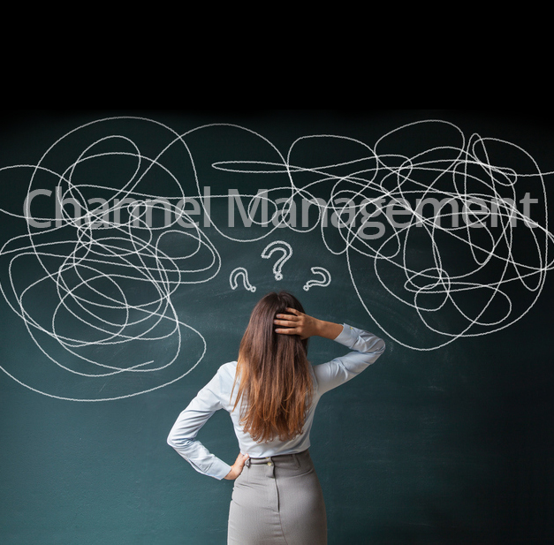
How Do You Define Channel Management?
Analyze the Effects
“Channel management” is a broad term that is generally not well-defined—even for people involved in channel activities. I’d like to remedy that. But before we take a deep dive into channel management definition, let’s step back for a moment and think about what the word “channel” means.
Merriam-Webster (https://www.merriam-webster.com/dictionary/channel) defines the word “channel” in multiple ways, as follows:
the bed where a natural stream of water runs
the deeper part of a river, harbor, or strait
a strait or narrow sea between two close landmasses [e.g., crossed the English Channel]
a means of communication or expression: such as (1): a path along which information (such as data or music) in the form of an electrical signal passes (2) channels plural: a fixed or official course of communication [e.g., went through established military channels with his grievances]

Slide 3

How Do You Define Channel Management?
a way, course, or direction of thought or action [e.g., new channels of exploration]
a band of frequencies of sufficient width for a single radio or television communication
When you consider of the many possible definitions of the word “channel,” and then when apply a more generic term like “management”, it’s easy to see how you can end up with a broad range of definitions. However, for the purposes of this article, I’d like to focus on an altogether different phrase: “an indirect way of going to market.” With that basic concept firmly in mind, I’d like to propose a more complete, and hopefully more explicit – channel management definition:
Channel management is a set of activities—including resource allocation—in which an organization defines and manages marketing and sales processes, people, policies and platforms to deliver goods and services indirectly through partner organizations. The goal of these activities is to maximize revenue at the lowest possible cost. Such activities are referred to collectively as “channel management.”

Slide 4

How Do You Define Channel Management?
Now that I have taken a shot at defining channel management, I’d also like to present a series of “sub-activities” related to channel management. These sub-activities coincide with the five stages of channel management—channel partner recruitment, channel partner onboarding, channel partner training, channel partner co-marketing and channel partner performance management. Each of these five stages has, in turn, multiple sub-stages or steps. The purpose of each step is to enable an external secondary organization (called a channel partner, reseller, agent, system integrator, consultant, etc.) to resell and support the products and services of a primary organization (called a vendor, OEM, supplier, etc.) in an efficient and cost-effective way.
Most organizations grow from their early start-up phase and expand their businesses globally. Even so, the channel management definition doesn’t vary that much from one country to another. Like other functions, such as accounting, legal, marketing, sales, manufacturing, services, and so on—where the core activities are primarily the same across all countries and cultures, but do require some level of localization—channel management also has core activities that are only somewhat localized in each country and culture.

Slide 5

How Do You Define Channel Management?
Indirect ways of going to market have existed for ages. In fact, the driver behind human migration from one continent to another, from the time of our earliest ancestors to the present, has always been based on the nearly-universal desire to move to a better place. These movements have created a global integration of culture over the ages, and part of that integration process is reflected in unified “channel management” activities that bring buyers and sellers together around the world.
The formal pursuit of channel management has opened up indirect ways of going to market for companies by making it easier for them to partner with other organizations for mutual gain. Channel management has increased reach for these companies at a much lower cost and at greatly reduced commercial risk, thereby increasing revenue.

Slide 6
Automating Profitable Growth™

