Slide 1
Automating Profitable Growth™
ZINFI Offers Free Unified Channel
Management Guidebook (PDF)

Slide 2
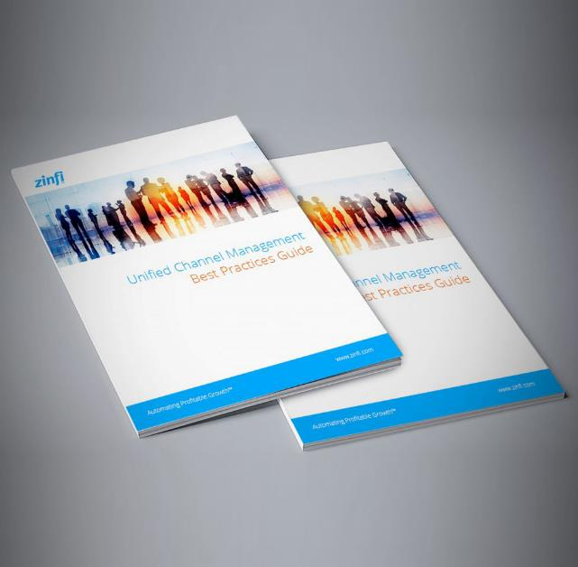
ZINFI Offers Free Unified Channel Management Guidebook (PDF)
Did you know that ZINFI’s Unified Channel Management (UCM) guidebook is available to you free of charge in PDF format? You can download the channel management PDF guidebook now by clicking on this link. The guidebook tells you everything you need to know about channel management in today’s marketplace, and discusses a variety of best practices designed to help you implement a sound channel management strategy for your organization in a logical, step-by-step fashion.
Let me give you a brief overview of what this channel management PDF guidebook covers and why it is relevant.
Channel management as an indirect sales management function has been evolving rapidly over the past few years. It is becoming much more organized, structured and predictive. Just as marketing automation has transformed the theory and practice of marketing over the past decade, the automation and integration of channel management functions is revolutionizing how companies manage their channel today and how they plan for the future.

Slide 3
ZINFI Offers Free Unified Channel Management Guidebook (PDF)
Until recently, channel management has been a largely ad hoc activity, governed by few formal and proven best practices. Companies simply recruited channel partners as best they could, trained them more or less randomly, and hoped that by signing up more partners they would guarantee that they would sell more. Those partners who generated more revenue got more attention, and those who didn’t sell enough were penalized by having only limited access to the corporate resources they needed to generate more transactions. However, the limitations of this very basic channel strategy have now become clear—especially in today’s complex, fast-paced, global business environment—and this simplistic (and largely ineffective) revenue-focused approach to channel management is now being replaced by a more sophisticated model.
Companies selling through the channel today are acutely aware that the channel is evolving rapidly with more formal processes, with the advent of comprehensive purpose-built automation platforms and with the use of a variety of powerful business intelligence tools. Today, organizations of all kinds and sizes, and operating in just about every vertical, can take defined steps to expand their reach on a global scale to end-user markets by adopting a well-thought-out and fully automated approach to channel management.

Slide 4
ZINFI Offers Free Unified Channel Management Guidebook (PDF)
In ZINFI’s Unified Channel Management Best Practices guidebook, which we have made available in PDF format, you will find a wealth of details related to the management of the entire partner lifecycle, including best practices in channel recruitment, engagement, lead generation, sales enablement and much more.
The channel management PDF guidebook emphasizes the importance of having a long-term, comprehensive approach to channel management to maximize your investments. It explains the fundamentals of partner relationship management (PRM), partner marketing management (PMM) and partner sales management (PSM)—how they are different, how they overlap and complement each other, and how bringing a systematic approach to each set of capabilities can have a dramatic impact on your success in the channel. Channel management processes, tools, software, strategy and training are all covered.
You can download this guidebook by clicking here.

Slide 5
Automating Profitable Growth™

