Slide 1
Automating Profitable Growth™
3 Things Channel Sales Needs in 2018

Slide 2
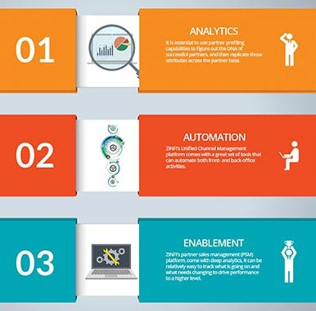
3 Things Channel Sales Needs in 2018
Channel sales can be exciting or frustrating or both at the same time. Those of you who are in channel sales will know what I am talking about. For example, if you have already built a run rate business in channel sales, then it you know it can be very exciting because you can predict what will happen, but it can also be frustrating when you realize you can’t change the direction or velocity that quickly. From another perspective, starting a channel sales operation from scratch is often frustrating and overwhelming, yet it can turn out to be quite exciting as you try new things that actually have an impact and help you make significant progress.
In this article we will explore how organizations can reduce the frustration associated with channel sales and unleash the excitement as we head into the coming year.

Slide 3

3 Things Channel Sales Needs in 2018
Insights drive focus. It is essential in today’s metrics-driven business world to use the right data to guide sales. While this approach is quite common in direct sales, in channel sales numbers can be hard to get and most channel managers do not have access to deep analytics. In order to build a high performing partner base, channel sales needs to focus on understanding which territories, partners, products and business lines are productive and why. In particular, it is essential to use partner profiling capabilities to figure out the DNA of successful partners, and then replicate those attributes across the partner base.
The right metrics have the potential not only to drive front-office productivity—e.g., figuring out what territory coverage (inside/outside, etc.) should be—but they can also help an organization figure out how to take operating costs out of channel sales by removing redundant or non-value-added steps.

Slide 4
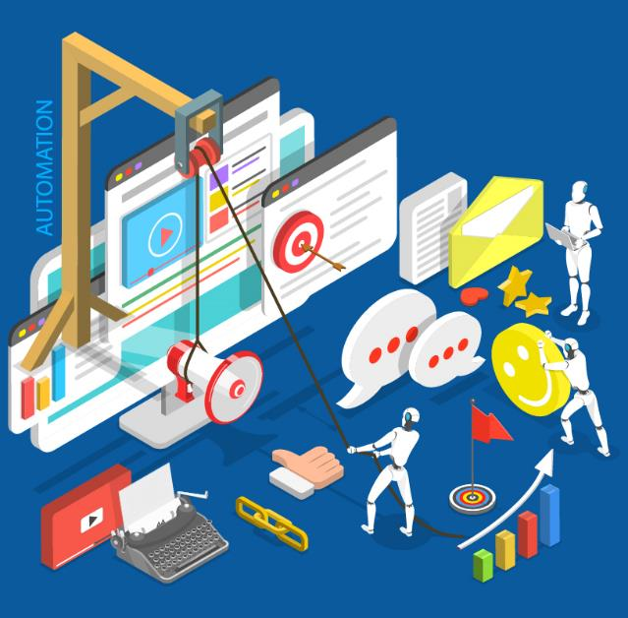
3 Things Channel Sales Needs in 2018
Automation is key. Gone are the days when high-performing sales teams run their operations primarily on Excel, Word and PowerPoint. While these are great complementary tools, they do very little to automate the workflow, remove non-value-added steps or provide meaningful insights into what is working and what needs improvement. Organizations focused on channel sales need to prioritize their efforts and investments where the impact will be greatest. If the organization is very complex due its size and distributed nature, then it makes sense to focus on front-end, market-driving activities. On the other hand, if the organization is able to map its workflow and figure out how and where to automate, then back-end automation can significantly reduce costs and drive productivity.
In most cases, when channel sales focuses on both channel marketing and sales alignment through automated process steps, sparks start to fly and great things happen. We see this again and again across our customer base of companies of various sizes and complexity. ZINFI’s Unified Channel Management platform comes with a great set of tools that can automate both front- and back-office activities.

Slide 5

3 Things Channel Sales Needs in 2018
Digital enablement is foundational. In addition to automating channel sales workflow to take costs out and increase efficiency, it is also essential to make sure partners have state-of-the-art digital tools. Most analyst firms confirm that today’s buyers are looking online first before they engage with any providers. Even if your own organization has a cutting-edge web or digital presence, it’s likely many of your partners do not. That’s why digital enablement is critical for channel sales. Organizations need to think through which components of enablement—e.g., training, tools, incentives, etc.—have the most potential to drive immediate impact and build excitement and focus. Since most digital sales or performance enablement tools, such as ZINFI’s partner sales management (PSM) platform, come with deep analytics, it can be relatively easy to track what is going on and what needs changing to drive performance to a higher level.
The true power of enablement is realized when all three core areas—training, tools and incentives—are fully aligned, and programs are put together by thinking through the details of these aligned intiatives.

Slide 6

3 Things Channel Sales Needs in 2018
As you can see, channel sales is primed for improving performance through digitization, automation and enablement. We can do more with less as we move forward. If you want to learn more how your organization can benefit from specific channel sales enablement initiatives, please download ZINFI’s Unified Channel Management (UCM) Best Practices guide.

Slide 7
Automating Profitable Growth™

