Slide 1
Automating Profitable Growth™
What Is Channel Management Software?

Slide 2

What Is Channel Management Software?
Over the past decade, we have seen the rise of channel management software. The primary buyers of channel management software have been large enterprise organizations, and they have invested enormous amounts of time and resources to customize channel management tools in order to better manage various sets of channel activities.
Most recently, there has been a rise in the deployment of more purpose-built, easy-to use channel management software systems from providers like ZINFI, as well as a few other players in the marketplace. This new generation of channel management software comes with a whole new set of capabilities. In this article, we will define what today’s state-of-the-art purpose-built channel management software can do.
But before we go into more detail about what today’s channel management software can do, let me first explain what channel management is all about. Here is how I have defined channel management elsewhere:
Channel management is a set of activities—including resource allocation—in which an organization defines and manages marketing and sales processes, people, policies and platforms to deliver goods and services indirectly through partner organizations. The goal of these activities is to maximize revenue at the lowest possible cost.

Slide 3
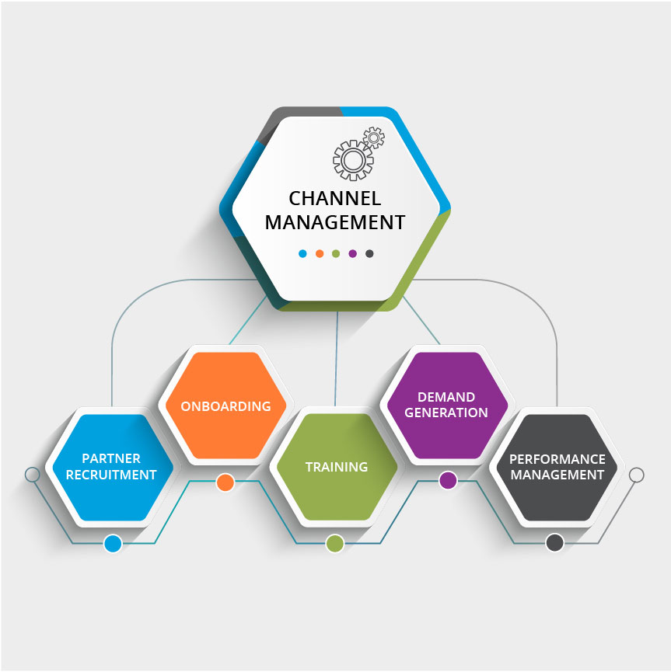
What Is Channel Management Software?
Now, channel management tends to focus on a set of five core activities: partner recruitment, onboarding, training, demand generation and performance management. State-of-the-art channel management software must be able to address all of these activities.
The core purpose of channel management software is to increase productivity by managing a set of channel partners, which involves enabling, training and engaging partners in a better way to drive higher revenue at lower cost.
With this in mind, it’s clear that any state-of-the-art channel management software must have a toolset that a supplier selling through the channel can use to recruit partners, train them and the drive demand generation activities using various integrated marketing tools. The channel management software system should also come with performance management tools for activities like lead management and deal registration, as well as incentives management tools like market development funds (MDF), co-op, rewards and rebates.
The future of channel management software is quite exciting. ZINFI is the leader in the Unified Channel Management (UCM) segment and currently provides three core, completely integrated solutions: partner relationship management, partner marketing management and partner sales management.

Slide 4

What Is Channel Management Software?
Each of these solutions focuses on one or two core sets of activities. For example, the partner relationship management solution is focused on providing partners with the latest news about a supplier’s channel programs, its marketing and sales assets, and so on. This channel management tool also helps organizations manage the distribution of leads. On the other hand, a partner marketing management solution focuses primarily on generating demand by enabling partners with a set of integrated marketing tools. A partner sales management solution tends to focus on enabling partners to sell and close opportunities.
It’s worth repeating: The future of channel management software is quite exciting, and it is rapidly evolving. ZINFI recently launched a fully mobile application that allows partners to run their business by accessing content and tools on the go. A native mobile app like ZINFI’s gives partners faster access to data and content, as well as offline access, unlike a mobile-responsive partner portal or tool. A fully featured mobile app can have a considerable impact on partner productivity and satisfaction.

Slide 5

What Is Channel Management Software?
Channel management software continues to evolve. In addition to becoming mobile, it has also become extremely intelligent. ZINFI’s latest channel management software comes with a business intelligence application that allows users to build predictive models and develop actionable insights that will drive profitable growth. All of these enhancements are making it easier—and more profitable—for companies to conduct business in the channel.

Slide 6
Automating Profitable Growth™

