Slide 1
Automating Profitable Growth™
Alexa, Who Are My Best Customers?

Slide 2

Alexa, Who Are My Best Customers?
Yes, I know, as marketers we wake up every morning trying to figure out the answer to this question. Whether they are new or existing customers, the primary job of a marketer is to figure this out. The question is: When will Alexa (a.k.a. artificial intelligence) be able to answer this question on the fly? The simple answer is either now or never. “Huh,” you ask? “This statement makes no sense.” Well, please hear me out and see what you think.
At this very moment in the marketplace, three things are free: processing, storage and bandwidth. When I say “free,” I don’t mean you can walk into a store, grab a computer and walk out without paying. I mean these three things are near-free when you compare the very modest cost to the insights they can harness, provided you have one thing: the right software, or what I prefer to call “intelligence.”
In the recent years there has been a lot of mumbo jumbo bandied about around a few choice buzzwords like cloud, digital transformation, big data, predictive analytics, artificial intelligence and so on and so forth. However, the reality today is not markedly different from the reality a decade or two ago. You have a bunch of data about your customers, you build mathematical models to delve into them, and then you build a forecast that is supposed to tell you who will buy a lot versus a little, who is most profitable versus loss leading, and who will no longer need you a year or two down the road.

Slide 3

Alexa, Who Are My Best Customers?
The mathematics, the computational logic, the platform, the people—all have existed for quite a while now. If that’s so, how come most companies cannot answer this simple question today: Who are my best customers? And why is there this persistent fantasy that one day some automated voice from the cloud will be able to provide answers with purpose, clarity and certainty? Well, in reality, the truth is that for a few companies the answer already exists. For many others, however, the truth is they don’t have a clue. And that has nothing to do with Alexa, but more to do with who is asking.
“Wait,” you must be saying, “so it’s my fault?” I am sorry to say so, but the answer is ‘yes’. If you are still clinging to the hope that one day Alexa will magically answer this question for you, I have really bad news for you. The only thing you will hear back from Alexa is, “I am sorry, I have no idea who your best customers are.” So the question becomes, “How do I make Alexa figure this out?” The answer is in you — not in Alexa.
What I mean by this is you need to do three things right. To make this crystal clear, I will simplify (mathematicians please cover your ears).

Slide 4

Alexa, Who Are My Best Customers?
Learn more faster – You need to collect as much data as possible (legally, of course) about your customers: who they are, where they live, what they eat, what they like or dislike, what web pages they visit, what they read, what they skip, what they check out to buy, what they return and why, and what they purchase repeatedly and recommend to others.
Try and fail early – Once you have all of these data points, try to build clusters and segmentations of customers that behave in a similar way, and figure out what drives their motives, not their intent. Yes. I know this is hard to do, but guess what? Rome wasn’t built in a day. This will take time, but you must try and fail to determine their motives—what they buy and why—until you get it right.
Follow the money quickly – In many ways, this is the most important part. You will need to figure out who the profitable accounts are, what makes them happy and what keeps them happy. However, at the same time you need to figure the value of their “peer-fluence”—i.e., how your best customers can influence similar people or organizations to buy your products and services.

Slide 5

Alexa, Who Are My Best Customers?
Now, in addition to these three things, you must know where you want to go as a business. Of course, this question cannot be answered in isolation from your understanding of your best customers, but you must know. A sage once told me, “If you don’t know where you are going, any road will take you there.” In this case, any road won’t do; you must know where you want to go.
So: when you know where you are going and you know the important details about your customers, especially the clusters and segments they belong to, and you have determined how you can serve them to make money, then you actually have the foundation to build an intelligent organization that can answer what Alexa cannot today.
There is a lot of hype and mystery in the media about artificial intelligence. There are actually two things worth knowing about it: First, it is intelligent and, second, it is artificial. Even though Artificial Intelligence is rapidly evolving into other cognitive areas where it can understand and predict beyond what it knows, the success in that dimension has thus far been quite limited. Artificial Intelligence’s usefulness is still limited to computing and modeling based on the data it has, but it can find answers much faster than a human could. There has been enormous progress in multiple sensory dimensions—voice, video, imaging, touch and even smell—core capabilities that are a key part of what makes us human. However, when it comes to the fundamental factor of being human—consciousness—no data or Artificial Intelligence scientist has figured out how to emulate that consciousness in a convincing way.

Slide 6
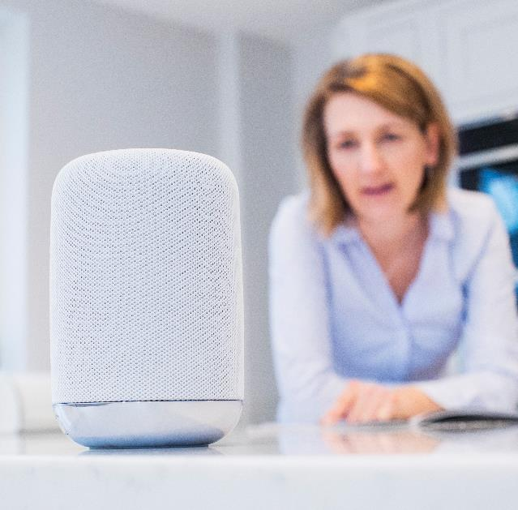
Alexa, Who Are My Best Customers?
Why do I suddenly bring up this notion of consciousness? Well, to answer the question I began with—who my best customers are—you will always need to consider two dimensions. One is derived from data, which Alexa one day (may be even today) can answer, provided you feed Alexa with all the elements I described earlier. However, there is also a human, and very important, dimension that requires consciousness, which encompasses the other, “softer” yet incredible dimension that includes factors like ethics, morality and judgement—so that companies do not misuse the data and technology they have at their disposal to, say, manipulate political views or mislead customers or sell inappropriate goods to minors or addicts or other vulnerable people.
The time is coming soon when Alexa (or her namesake) will be able to figure out instantly who the most profitable customers are based on the data you have fed her. But this question will remain: “Are they still the right ones to go after and serve?” Ultimately, that is a moral question that Alexa will probably never be able to answer. This is why I said at the beginning of the article that the answer to the question, “When will I know who my best customers are?” may be now or never. It doesn’t depend only on data; it also depends on what is right, and we need sound judgement to determine that. No one really knows whether Alexa will ever develop true consciousness and be able to make sound moral judgements. It very well could be never.

Slide 7
Automating Profitable Growth™

