Slide 1
Automating Profitable Growth™
Can You Configure Your PRM Software?

Slide 2

Can You Configure Your PRM Software?
Partner relationship management (PRM) software has been around for a while now—about a decade or little more. In its early days, PRM software was essentially a partner portal that typically patched a few applications together. However, in recent years it has become an essential business process automation platform for organizations engaged in partner relationship management activities.
As PRM software has evolved into an automation category in its own right, the deployment scope has broadened quite a bit across multiple verticals and a broad range of company sizes and types. This has created a new challenge, and begs the question: Can one size can fit all? On the one hand, if you build a software platform that has the features for all verticals and company sizes, you risk creating what is essentially bloatware, and many customers will end up paying for a lot of features they don’t need. On the other hand, software that doesn’t have all the relevant functionality for a specific kind of deployment would be essentially useless. In light of that dilemma, it seems to me we need to ask a different question: What does PRM software need to be able to do at its very core?

Slide 3

Can You Configure Your PRM Software?
The answer is simple. It needs to be fluid. In other words, it needs to be able to “flow” into any business environment and adapt to any unique set of requirements. But, you ask, “How is that possible?” Well, I’m here to tell you it’s not only possible, but actually available today in ZINFI’s Unified Channel Management platform. Now you ask, increasingly skeptical, “Well what does that mean, exactly?” It means what I say: ZINFI now has a platform that can adapt to any business environment. How do we that? The answer to that question requires a little more discussion of what effective PRM software needs to be.
When you think about the term “partner relationship management,” well, every one of these words is important. “Partner” refers to an entity that you need to interact with that is outside your organization. “Relationship” is important because the nature of that interaction necessarily varies considerably from one segment to another, because the way business works in the retail environment is different from the way it works in real estate or healthcare or manufacturing. The way business relationships are conducted between organizations is a direct function of the nature of the business or vertical in question. Finally, “management” refers to the work you do within your company and the work you do with your partner companies to get the most out of those relationships. All of these activities need to be properly prioritized and formally managed. Therein lies the complexity of partner relationship management and — until now — no single platform has been able to adequately address that complexity.

Slide 4
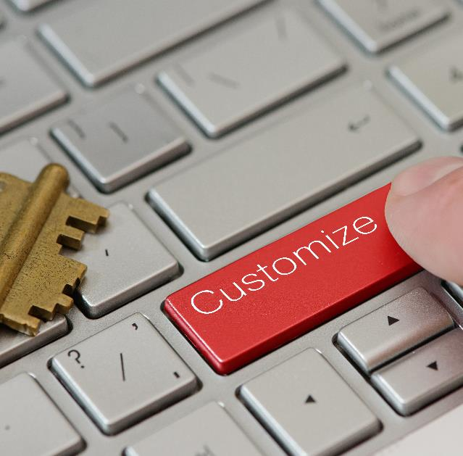
Can You Configure Your PRM Software?
ZINFI’s Unified Channel Management (UCM) platform is unique because it focuses not just on providing a set of software applications out of the box, but also a complete set of configuration tools that are super intuitive and easy to use. By leveraging these configuration tools, any channel operations team can configure and modify ZINFI’s out-of-the-box applications to fit into their specific business requirements with just a few hours of work. Even more important, since most organizations’ channel requirements change frequently, the channel operations personnel can access these tools and easily change forms and workflows on an as-needed basis.
And there’s more. Configuring PRM software (forms and workflows) is certainly a very important first step in making the platform work for you, but the next important step is to create dynamic reports that can show you exactly what’s going on across all the various parts of your channel. It may sound like a fairy tale, but I assure you it is not. You can do this on your own with the tools our platform provides. If you are talking to a PRM software vendor who wants to saddle you with a big bill for professional services required to set up and maintain the platform, my advice to you is RUN!

Slide 5
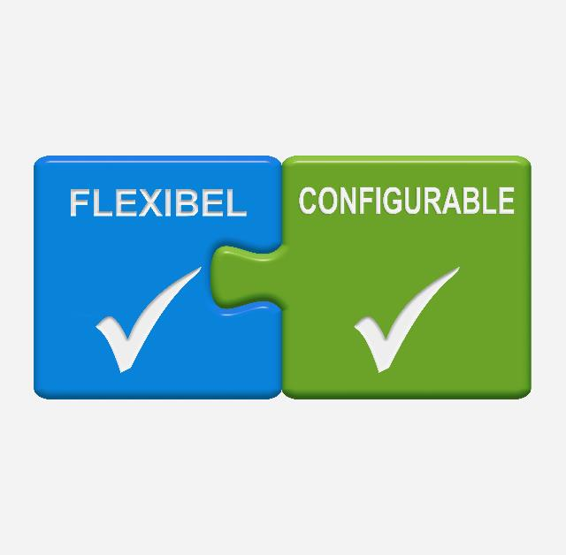
Can You Configure Your PRM Software?
The cloud-based platforms of today are very different from solutions that seemed state-of-the-art just five and or 10 years ago. Ask your PRM software vendor, “When was the last time you re-architected you entire platform?” “What technologies do you use and why?” Look for analyst reports that rate PRM software on their technology strengths. Then, choose wisely. Make sure you end up with software that is fully flexible and configurable like ZINFI’s Unified Channel Management platform.

Slide 6
Automating Profitable Growth™

