Slide 1
Automating Profitable Growth™
What Is Channel Management?

Slide 2
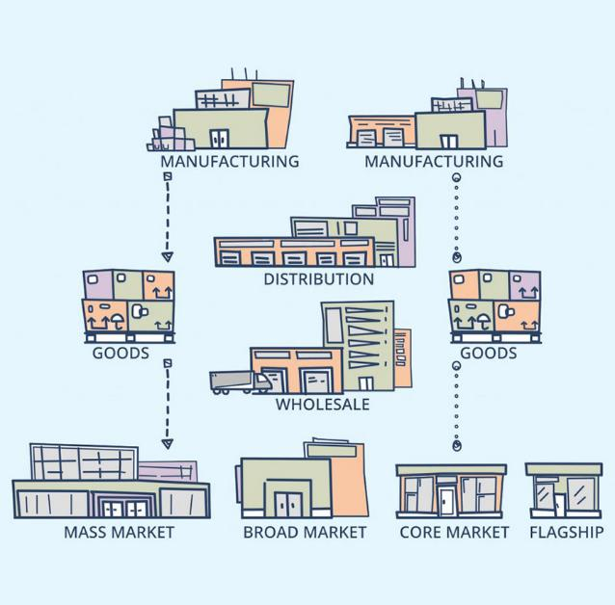
What Is Channel Management?
The word “channel” indicates a passageway through which something flows. Channel management is a discipline in management science in which a vendor organization or “brand” creates, captures and fulfils market demand via another set of organizations who act as channel partners and ecosystem players for the subject vendor. These channel partners act as a kind of mechanism that enables the orderly “flow” or distribution of products and services for the vendor to the end customer. In this article, we will expand on this basic view of channel management and attempt to explain in more detail how it functions in real-life scenarios.

Slide 3

What Is Channel Management?
Any for-profit organization—and even some non-profits—that depend on providing products and services to customers in order to survive require two core functions: sales and support. In today’s world, most organizations that sell products and services also require a marketing function. The entire goal of a commercial organization, in fact, is to find buyers, make them aware of the vendor’s products and services, provide those products and services for a fee, and then, as a part of this transaction, make a reasonable profit. Now, we all know profit is a function of revenue minus cost. If the cost to acquire, deliver and serve exceed the revenue the company generates, then it becomes unprofitable to serve a specific group of customers. This is where a “channel” organization and channel management come into play by enabling cost-effective sales and support for vendors on a larger scale than is possible through direct selling alone.

Slide 4

What Is Channel Management?
The primary purpose of a vendor’s channel organization is to build relationships with a set of other organizations that can resell and support the vendor’s products and services. The core feature of this relationship between the vendor and the partner organization is their mutual interest in increased profitability. For the relationship to succeed, the vendor organization should be able to reach, acquire and serve a large number of end customers at a relatively low cost compared to selling directly, and the partner organization should be able to increase profitable revenue by providing the vendor’s products and services, along with the other products and services the partner sells.

Slide 5
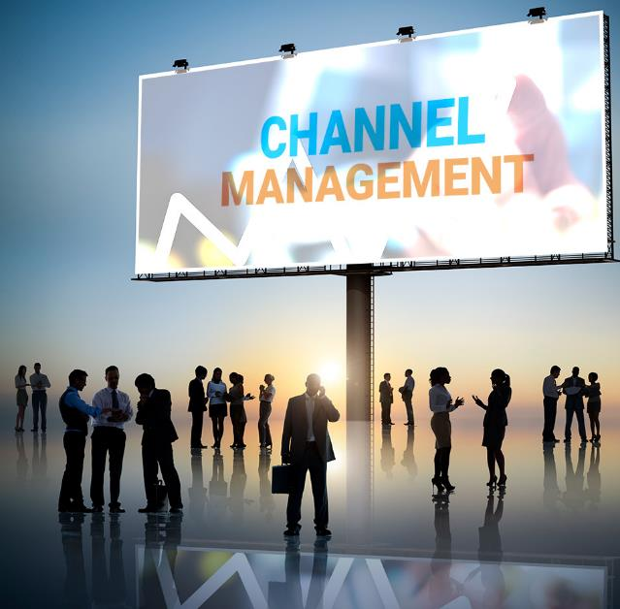
What Is Channel Management?
With this as a backdrop, we can now see that channel management basically entails five core phases, as outlined below:
Partner recruitment – The focus of this phase is to reach out to and build relationships with potential organizations that are able to sell and support a vendor’s solution.
Partner training – The focus of this phase to ensure partners’ functional teams are properly trained on how to market, sell, deploy and support a specific solution
Partner enablement – This phase focuses on making sure the partner marketing, sales and technical personnel have the right tools to do their job.
Partner sales – The entire focus of this phase is to drive increased sales via partner organizations via new accounts and partners’ existing customers.
Partner management – This phase focuses on introducing effective performance enhancement incentives and programs tied to training, certification, sales improvements, quota attainment, etc.

Slide 6

What Is Channel Management?
Channel management is a discipline all its own, but it also tends to build up all other cross-functional areas of an organization, such as marketing, sales, operations, finance and legal. In the case of a channel organization, the traditional direct functional disciplines must undergo adaptations to fit a specific channel requirement, as follows:
Channel marketing – This functional group focuses on driving awareness in the partner base to recruit and enable partners with new programs and initiatives. This group also takes content from the direct marketing team and adapts that content for partner use in end-user lead generation.
Channel sales – The focus for this functional group is to train and help a partner close a new transition or grow an existing account. Unlike direct selling, where a sales rep of a vendor directly calls up an end customer or prospective buyer, channel sales activities are conducted through a partner organization.
Partner development – This group focuses on ensuring partners are properly trained and certified to go after certain solutions. In many cases, the partner development organization also manages alliances or other vendors who “white label” a vendor’s solution.

Slide 7

What Is Channel Management?
Channel operations – The focus for channel operations is on managing channel inventory, and this function relies upon supply chain management capabilities, but traditionally the channel operations group focuses on the front end of the channel—i.e., distribution partners—to make sure products are available and returns are properly managed.
Channel finance – This function makes sure resellers who are buying on credit have the right capabilities and credit rating in place to support a sales transaction. In order to ensure proper payment and approve special pricing, channel finance works hand-in-hand with channel sales and operations.
Channel legal – The focus for this function is to make sure there are always updated contracts between a partner organization and the vendor organization. In case of channel conflict, this function also mediates disputes.

Slide 8

What Is Channel Management?
While these six functions are not indicative of every channel organization, I use them for illustrative purposes to make the point that channel management is very much like business management, but it is conducted indirectly through a set of partner organizations. So, while traditional direct functional teams may not be needed if an organization’s focus is exclusively on a channel-only model, it is important to remember that channel management itself is a cross-functional discipline and requires all traditional business functions be properly adapted for a specific channel configuration.

Slide 9
Automating Profitable Growth™

