Slide 1
Automating Profitable Growth™
How Process Automation Competencies
Can Grow Your Digital Agency

Slide 2

How Process Automation Competencies Can Grow Your Digital Agency
It’s 11:00 p.m. and you are looking at your cash flow statement, wondering how you are going to prioritize your payroll, expenses, etc. because one client is going to pay late due to some delivery issues, or one of the signatories at a client level has moved on and the invoice is stuck for payment. This is the story of every small to midsize digital agency trying to fulfill the dream of building a thriving, sustainable business, and yet struggling with day-to-day issues of existence. There is, however, a way out of this trap and a path to profitable growth. I can say this because I have been in your shoes.
Marketing people tend to be highly creative, and therefore to some extent unstructured. However, in today’s world of efficiency, automation and ROI-driven culture, a lack of efficiency can easily make or a break a digital agency. No matter how much structure you try to bring in, day-to-day chaos gets in the way. This is where process-driven automation capabilities can make a decisive difference. The more you can automate and make the system work for you, the more chaos you can handle on a daily basis.

Slide 3

How Process Automation Competencies Can Grow Your Digital Agency
After more than a decade of working for large Fortune 100 brands, we at ZINFI have learned that the best way to serve these companies at a global level is to take a rigorously structured approach to everything we do. We set up operations that can run fast, but we also have developed the habit of thinking the way these bigger companies think. That means we establish a clear framework for budgeting, allocating resources, spending on training and building up the competencies of employees.
Over the last 10 years, we made the transition from a small digital-channel marketing agency to a full-blown SaaS company with the #1 product in our market category. It happened because of our commitment to the framework of product, process and people. This may sound like a cliché, but in the case of our organization this approach turned out to be a significant competitive advantage. Please allow me to elaborate:

Slide 4
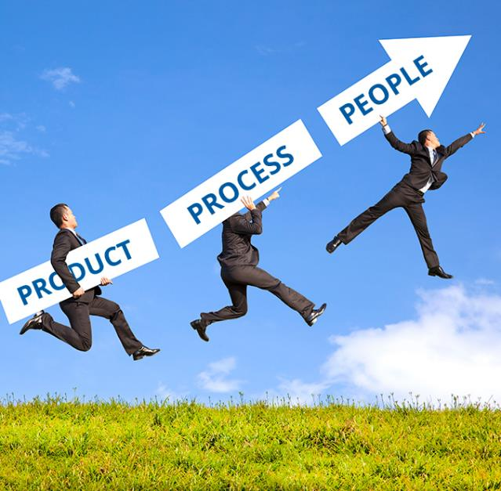
How Process Automation Competencies Can Grow Your Digital Agency
Product: If you are a successful digital marketing agency, then you probably have built expertise in a variety of technical tools and products like Adobe Photoshop and Creative Suite as well as various audio and video editing tools. It’s also very likely you have adopted and developed expertise in one or more marketing automation tools like Eloqua, Marketo and HubSpot. These kinds of competencies are essential.
Process: You cannot use marketing automation tools effectively unless you think in terms of steps and processes. Once you have this capability, however, you can extend marketing automation into additional growth segments by leveraging what Forrest calls “third-wave business process automation”—also known as channel marketing automation.
People: People are the lifeblood of any company, especially for a digital marketing agency, where people are the product. Your business is all about billable hours, which means you are selling the competencies of your people in bite sizes. Without those people, you can’t claim product or process expertise. People power everything—including your future growth.

Slide 5

How Process Automation Competencies Can Grow Your Digital Agency
Therefore, to continue building your digital agency business and thinking forward, your people-driven products and processes must be a core competency. The challenge that most digital marketing agencies face is that their services get commoditized as more and more agencies provide similar services and rely on references to win new business. When you reach this point, you are ready to consider the third wave of business process automation: channel marketing automation.
Process-driven thinking is a rarity in the marketing profession, but it is absolutely in high demand in this age of automation. If your organization is already capable of effectively automating marketing processes, then you have huge potential for rapid and sustained growth. We at ZINFI can help you enable such growth by leveraging our world-class, industry-leading product and our channel process management and automation expertise. Your process automation competency combined with our expertise can make all the difference as you work to build a high-growth and profitable digital agency business.

Slide 6
Automating Profitable Growth™

