Slide 1
Automating Profitable Growth™
How the Coronavirus Will Forever Change
the Way We Work

Slide 2

How the Coronavirus Will Forever Change the Way We Work
Actually, it has happened already, right? From ordering toilet paper to hand sanitizer to lunch and dinner, over the past few weeks we have exhausted nearly all possibilities that exist on the Internet. And chances are, we will not fully return to the way we were. This side-effect of the pandemic (Coronavirus) is creating a huge market shift from brick and mortar to online—and quite possibly represents a third wave of Internet-enabled innovation. The first one was when book sales went online via Amazon. Then professional services—like learning, testing, healthcare, accounting, etc.—went online. Now it’s personal goods and services. Yes, Uber Eats, Grubhub, Instacart and others have been around for a while, but try placing an order with these businesses now. I wouldn’t be surprised if you had to wait a week for delivery. But necessity is the mother of invention, and the current situation will create a huge disruption in this space—a tectonic shift that will happen almost overnight.

Slide 3

How the Coronavirus Will Forever Change the Way We Work
As you contemplate this shift on the supply side for personal goods and services, imagine the impact it will have on the back end of these delivery points. The salesperson who went from restaurant to restaurant selling equipment, goods and services will now have to sell to an aggregator. The restaurant equipment provider who sold via a distributed network of providers will now have to think like Intel— ship to a few large chains that have aggregated delivery systems. Front-end restaurants will suddenly become “packaged-food” retailers. True, all of this won’t happen by end of the year, but it will happen over the next decade. In much the same way that Amazon is now using Whole Foods for front-end stores that are supplied by fully integrated local warehouses, the channels for the entire personal goods and services market will shift dramatically over the next decade. This will create many new opportunities, and it will also disrupt many existing jobs.

Slide 4

How the Coronavirus Will Forever Change the Way We Work
Now, let’s keep thinking this through. Let’s focus on the businesses that used to sell to restaurants, shops, gyms and entertainment venues. They, too, will be forced into remapping their sales channels. The coming recession will drive up aggregation by those equipment providers as well. Even before the pandemic, the supply chain from China had already started to shift to other Asian developing countries and Africa due to the recent trade war. The pandemic and its aftermath will only accelerate that shift. So, globalization will no longer mean a trip to Shenzhen (China) or Mexico City (Mexico), but to places like Addis Ababa (Ethiopia).
As the entire supply chain shifts, despite a push towards nationalism in many countries, a potential fallout from the coming recession is that we will be even more connected—and more exposed to the next pandemics. This effect will be exacerbated by severe income inequality in many countries. The World Health Organization will move from being an alert organization—one that has had little practical impact on most countries during the past three months as the pandemic advanced—to serving as an international policy driver like the United Nations or International Monetary Fund or World Bank. We will likely be better prepared to protect ourselves against these types of novel enemies. We will also accelerate the collaboration that is happening among scientists around the world.

Slide 5
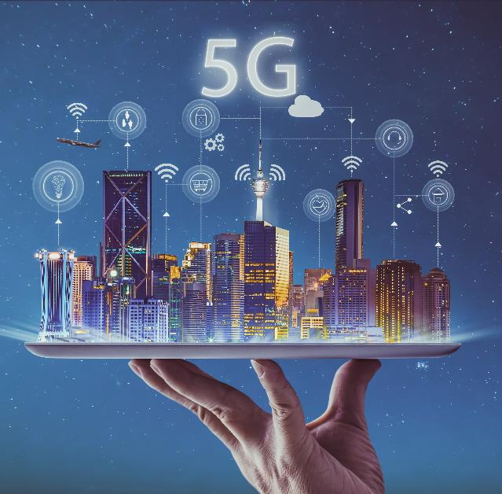
How the Coronavirus Will Forever Change the Way We Work
The cloud has played an important role in facilitating effective collaboration among scientists, engineers and manufacturers over the past couple of decades. Now we have many more collaborative tools—a few prominent examples are Microsoft Teams, Cisco WebEx and Zoom videos—as well as fast, inexpensive broadband, that allows us to access high-quality video and audio from home. This trend will only accelerate with the rollout of 5G. While some telcos will likely be at the brink of bankruptcy because of the huge amounts of debt they have incurred to build their networks, eventually the dust will settle, with some companies resurrected by bailout money or through M&As. The high-speed, high-capacity networks will survive, and they will change how we collaborate through video and audio.

Slide 6
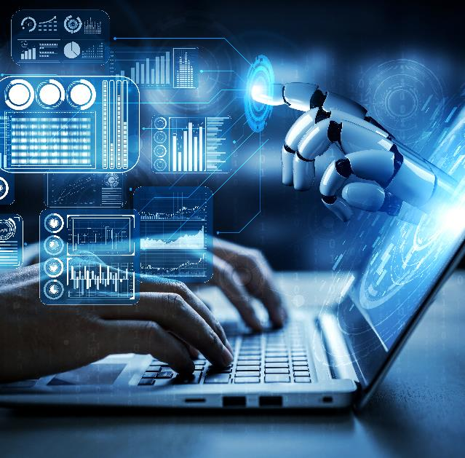
How the Coronavirus Will Forever Change the Way We Work
As both demand and supply chains shift, and we figure out a way to have our kids attend classes from home while we talk to customers and colleagues, we will continue to depend on a plethora of tools. Companies that sell through the channel will rely heavily on automated, scalable tools like partner relationship management (PRM), partner marketing management (PMM) and partner sales management (PSM) software. Companies that sell directly will focus on tools that integrate various forms of customer experience management. Each will emphasize deep vertical usage tied to the sectors they serve. As the cloud continues to get cheaper, bandwidth and storage will become practically free and computational costs will also become negligible. The use of powerful, advanced technologies from the time we wake up to when we go to bed will be routine.

Slide 7
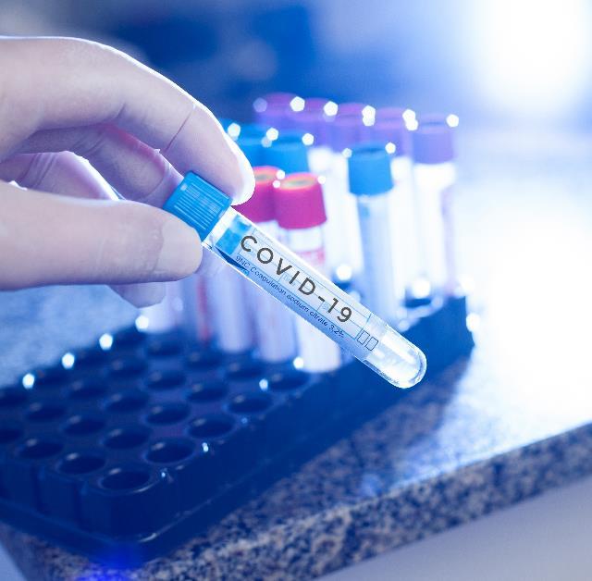
How the Coronavirus Will Forever Change the Way We Work
One last point I want to make: This is more of an observation than a prediction, based on how the scientific and technical communities are working together to come up with a coronavirus vaccine as well as anti-viral therapies to treat those who are already infected. While the academic and public scientific research communities—more so than the private sector—have always been highly collaborative in publishing research findings, collaborating via lab experiments and so on, it appears that the progress they are now making over a very short period of time is highly unusual and perhaps unprecedented. We also saw unprecedented coordination and collaboration among these professionals during the Ebola virus breakout, but because of the nature of that disease and its containment geographically, the world had more time to react to it.

Slide 8

How the Coronavirus Will Forever Change the Way We Work
Over the past few months, the scientific community has demonstrated how the path from fundamental research to commercialization can be rapidly accelerated with access to huge amounts of knowledge that is searchable with AI-based tools, advanced predictive modeling techniques and technology-enabled worldwide collaboration. One lab in one part of the world comes up with 69 potential drugs, and another lab takes that up, expanding research to hundreds more potential substances that may be useful for treating a new viral infection. We have experienced exponential growth and progress in the ways we store, search for, share and build upon information, and this will bring into the marketplace a whole new set of providers that will use existing and new channels for commercialization and distribution.
How we work collectively and collaborate within a community or country or globally has evolved to a whole new level, both at the micro level of individual workers and at the macro level of nations and regions. This is true of onsite work, but even more so of remote work, and the tools we use will continue to evolve and accelerate.

Slide 9

How the Coronavirus Will Forever Change the Way We Work
I realize at this moment the world looks quite dark, with mounting job losses, potential restructuring, looming M&As and other market-shifting changes, but when this is all over and we return to some semblance of normality, we as a species will continue to adapt and move to a higher level of excellence. This is how we discovered fire, developed agricultural practices and built villages, traveled on shaky seas to explore, survived freezing weather, sang songs, drew pictures on cave walls, laughed, and passed all of it on to the next generation so they could have better lives than what we inherited. The spirit of human innovation and collaboration will once again reshape and improve how we live and work—this is what will ultimately prevail, not the virus.

Slide 10
Automating Profitable Growth™

