Slide 1
Automating Profitable Growth™
What Can PRM Software Automate?

Slide 2

What Can PRM Software Automate?
In today’s business environment, every organization is asking its channel management team to do more with fewer resources. This is a common challenge for any channel organization. It’s not enough just to get busy—the key is to figure out how to drive partner recruitment, enablement, management and sales growth in a focused way. This is where partner relationship management (PRM) software can help significantly. In this article, we will explore some of the core activities that PRM software can help automate.
Before we take a deep dive into the specific activities that PRM software can automate, let’s discuss briefly how the activities tend to vary by company size.

Slide 3
What Can PRM Software Automate?
Focused channel (100 – 500 partners) – Companies in this category tend to sell through the channel independent of their own size. In our customer base at ZINFI, we have multibillion-dollar organizations that have only a couple of hundred partners, but we also have much smaller customers who have a few thousand partners. In a focused channel where there is a relatively small number of partners, the level of engagement and focus by the vendor organization is generally high. We will discuss later how PRM software can automate the core activities for a focused channel.

Slide 4

What Can PRM Software Automate?
Scaled channel (500 – 2,500 partners) – In this category, the higher total number of channel partners is generally a function of two main factors: a low-price product with a high reach that allows partners to build service revenue, or moderately complex solutions with a medium and focused reach that require specialized global delivery and support. There are always hybrids, of course, but for the sake of simplicity it makes sense to define a scaled channel in terms of these two primary scenarios. PRM software typically automates more activities in a scaled channel than in a focused channel.

Slide 5
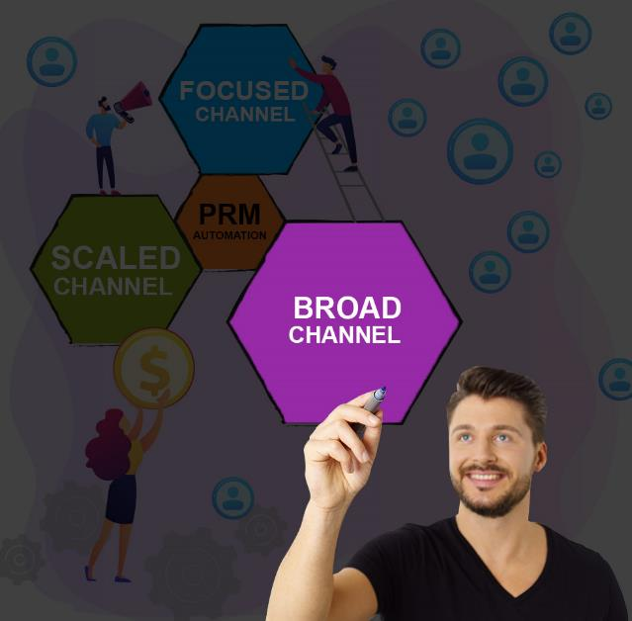
What Can PRM Software Automate?
Broad channel (1,000s of partners) ­– This category describes the channel for organizations with many products that are highly horizontal and broadly distributed. Prominent examples would include organizations like Microsoft, Google and Dropbox where usage of their products is quite horizontal. Certain household product companies are also good examples , although their products tend to get distributed through broadliners —e., large retail chains in developed countries, as well as lots of “mom and pop” stores in emerging countries. Overall, broad channels have higher levels of complexity and more demanding automation requirements than most focused or scaled channels. However, the right PRM software can significantly streamline and automate broad channel activities.

Slide 6

What Can PRM Software Automate?
The key to operating successfully in a focused or scaled or broad channel is understanding how your distribution strategy will ultimately support the growth ambitions of the company. For an organization with a niche product that has a relatively narrow focus, too many partners can create an over-distribution problem and make the product more difficult to sell. Therefore, before any PRM software can effectively automate and optimize channel activities, the organization’s channel strategy has to be closely aligned with the nature of its channel.
The critical factor in moving from a focused channel to a scaled channel and eventually to a broad distribution network is to have highly streamlined programs and an automation tool—namely, PRM software—that can effectively automate more activities as the organization’s business evolves. We know that automating a channel can be sequential: You start small and then build on your successes. This rule is most applicable to fast-growing companies. However, if your organization has already been around for a while and is already selling through a channel—focused, scaled or broad—you absolutely have the same opportunities to optimize effectiveness through automation by selecting the right set of tools.

Slide 7

What Can PRM Software Automate?
Let’s review briefly what you can do for each of the three main channel types—focused, scaled and broad—by aligning your channel strategy, programs, policies and PRM software automation platform.
PRM software for focused channel automation – If you are starting with a few hundred partners, the first thing you want to do is to put together a partner portal that has a highly customizable portal content management module to tailor pages, content and assets to various partner types, groups and locations. Make sure that you have turned on modules for a content library, a co-branded asset library, learning management and deal registration. These will significantly boost your ability to collaborate remotely in an asynchronous way on a 24×7 basis.

Slide 8

What Can PRM Software Automate?
PRM software for scaled channel automation – Once you have scaled your channel to where you have several hundred to thousands of partners, you will likely want to have the capacity to automate a variety of channel programs, policies, onboarding processes and more. That means you will need workflow automation capabilities that allow you to build custom workflows. You also should have the ability to create various types of dynamic reports that allow you to track key metrics and understand what is going on in your channel both globally and at the territory level.
PRM software for broad channel automation – Organizations optimizing a broad channel require everything that focused and scaled channels need, but also advanced workflow or activity automation modules such as business planning, contract management, lead management, MDF management and sales rewards. Theses are all workflow modules that allow for significant customization so you can automate by channel types, programs, geographies, territories, promotions and other criteria. In a channel with this kind of complexity, you need state-of-the-art PRM software that allows you to do all of these things easily and quickly.

Slide 9

What Can PRM Software Automate?
Before you embark on an automation journey using PRM software, make sure you vet potential vendors carefully. Your chosen vendor should have earned endorsements from leading analyst firms, received overwhelmingly positive reviews and generated positive feedback from its existing customer base. It should also offer a highly scalable and adaptable platform that can easily grow with your evolving channel needs. One thing you can depend on is this: Change is certain, and you always have to be ready to do more with less. A powerful, easy-to-use, highly configurable PRM platform is a critical tool for realizing this goal in real life.
I hope this overview has convinced you it is never too late or too early to start automating channel activities, provided you align overall business strategy, channel management activities and the right PRM software. Doing so will not only reduce waste but also significantly impact your return on investment—whether your channel is very focused or very broad or somewhere inbetween.

Slide 10
Automating Profitable Growth™

