Slide 1
Automating Profitable Growth™
What Is Email Marketing in
Through-Channel Marketing Automation

Slide 2

What Is Email Marketing in Through-Channel Marketing Automation
If you manage a distributed network of partners and they are more than just a fulfillment arm for you, then chances are you have considered through-channel marketing automation (TCMA). In this article we will explore one of the core tactics of TCMA—email marketing—and how it can be used as a part of your overall TCMA strategy. While email marketing has been around for a while, it’s not always used effectively. Refining your email marketing tactics can enable your channel partners to generate leads in a low-cost, highly effective fashion.

Slide 3
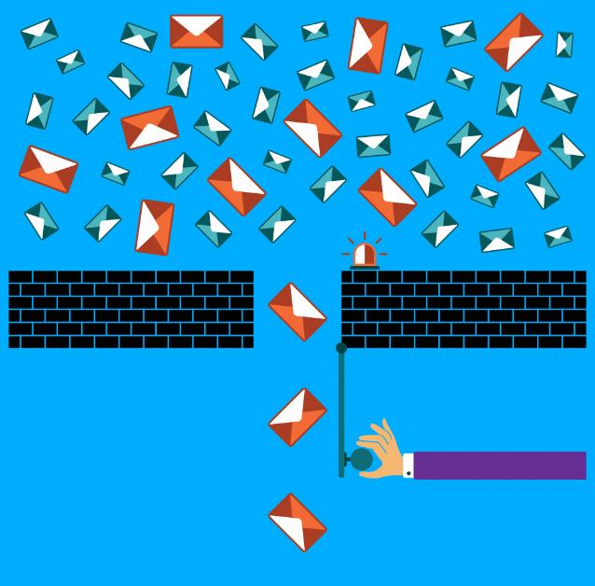
What Is Email Marketing in Through-Channel Marketing Automation
First, let’s briefly discuss what email marketing is and how TCMA-based email marketing tactics may differ from your direct email marketing efforts. We all know that email marketing was very likely the first digital marketing tool that marketers used, starting in the early 2000s. While we suffered through a plague of spam emails during much of that period—and even today a few of those spam emails get through the spam filters—it’s important to emphasize effective email marketing is NOT spam. Email marketing today relies heavily on obtaining end-users’ or target consumers’ email addresses through some sort of an opt-in mechanism, as opposed to various nefarious harvesting mechanisms that spammers use to collect or spoof email addresses. Once a proper prospect or buyer has signed up to receive emails from a provider, then and only then can a marketer use that medium to reach out in an appropriate way. This kind general leverages some kind of a marketing automation tool that relies on text-based or HTML-based email templates. In most cases, these templates are highly customized to convey a set of news, messages and/or offers that is likely to attract the interest of the targeted audiences.

Slide 4

What Is Email Marketing in Through-Channel Marketing Automation
Now, when it comes to email marketing tools for TCMA-related activities, it is important to have several critical features that are not necessarily relevant for direct email marketing tactics. These TCMA-specific capabilities include:
Template setup: In the case of direct email marketing, you set up templates predominantly for your own use or for a set of peers to use. However, in case of TCMA email marketing, you set up a master template that can be used by your channel partners, and you may decide to set up multiple templates for multiple partners and allow them to customize or not.
Approval routing: This is a critical feature in TCMA. This is used in cases where you may want your partners to send you their changes before allowing them to use a modified version of your master template. The primary purpose of approval routing is to maintain control over your message and brand positioning.

Slide 5

What Is Email Marketing in Through-Channel Marketing Automation
Co-branding: If you are requesting that your partners use your email templates, they will very likely want to add their logos and contact information, and some may also want to add customized content to augment your offer in order to, for instance, showcase their own expertise around your solutions.
Multi-touch: Drip marketing began to appear in the mid 2000s. This is a tactic where—based on the action a targeted consumer of your email—you may send a second or third follow-up email or “touch.” This tactic has evolved rapidly since those early days and is often an important part of integrated campaigns deploying a range of tactics. Drip marketing is a particularly effective tactic for through-channel marketing automation.
Click metrics: One of the most important features in email marketing for TCMA is the ability to track who opened and clicked through emails. When you are running multi-touch email campaigns, it is often very useful to track the success of your follow-on tactics and so you can identify the most effective messaging and offers and focus on that.

Slide 6

What Is Email Marketing in Through-Channel Marketing Automation
In addition to these core five areas, other features that tend to be important in a through-channel marketing automation (TCMA) email marketing tool include things like multi-tenant capabilities, copying, editing, reviewing, tagging and searching. We will discuss these features in another article.
However, before I finish this overview, I do want to point out that today email marketing is very rarely used as a single tactic, unless it is being used for a communication like a daily or weekly newsletter. In most cases email marketing is used as a part of an overall integrated demand generation strategy for through-channel marketing automation. When done effectively, it can drive significant ROI from your partner installed base or targeted regions by generating leads at a significantly lower cost than any other tactic.

Slide 7
Automating Profitable Growth™

