Slide 1
Automating Profitable Growth™
Connecting Your HubSpot CRM to a
Partner Relationship Management
Platform

Slide 2

Connecting Your HubSpot CRM to a Partner Relationship Management Platform
In the early 2000s we saw the rise of multiple CRM solutions. Most of them were on-premise, but some were cloud-based, even though at that time “cloud” was not the buzz word it is now. Over the past couple of decades, Salesforce stayed focused as a cloud CRM provider, and evolved into a massive SaaS ecosystem featuring a variety of business applications. Over the years, others like Microsoft and SAP followed suit, either through organic (built in-house) or inorganic (acquired) offerings. Some of these direct sales automation tools—for example, SAP—also introduced a bare-bones application for partner relationship management (PRM). Eventually, Oracle and Salesforce did as well, but none of these PRM applications could fully address automation requirements for the entire partner lifecycle.

Slide 3

Connecting Your HubSpot CRM to a Partner Relationship Management Platform
Now, while this was going on in the market space, HubSpot came into existence about a decade ago as an alternative platform for marketing automation, and over the past five years has evolved into a complete marketing and sales automation platform. HubSpot’s superior ease of use and its much-needed native integrations between marketing and sales have allowed it to capture a significant portion of the SMB and mid-market customer base. Many of these SMB and mid-market organizations are now looking for a full-featured PRM application. In this article, we will focus on how you can integrate your HubSpot with your partner relationship management application to create a seamless business process automation platform.

Slide 4
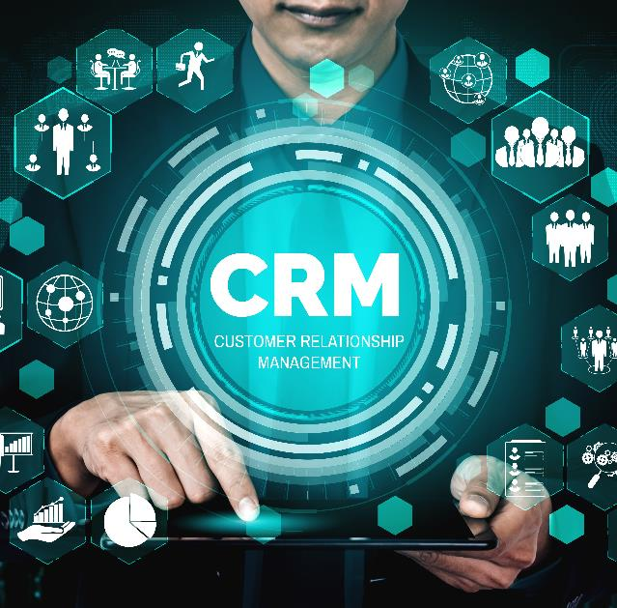
Connecting Your HubSpot CRM to a Partner Relationship Management Platform
In this age of working remotely—but also for the business folks on the go—sales operations move at the speed of digital. The days of keeping tabs on a sales pipeline in an Excel spreadsheet and updating those cells one at a time to create a report are gone. Today, customer relationship management (CRM) applications are table stakes for sales organizations. The scope of CRM has expanded into marketing (pre-sales) and services (post-sales). The goal of this category now is to provide a wholistic view of a buyer from engagement (prospect) to close (customer) to renewal (advocate). While there are many patchworks of tools that are available in the marketplace to slap onto a CRM platform, it requires significant process and interdisciplinary knowledge, integration of resources and, of course, additional money for different app subscriptions to extend a CRM like Salesforce into a multi-app business environment. This is why HubSpot is thriving as a single integrated platform that provides marketing and sales automation in an end-to-end fashion. I would not be surprised if their next offering is in the service management space—it simply makes sense.

Slide 5

Connecting Your HubSpot CRM to a Partner Relationship Management Platform
Partner relationship management (PRM) platforms today have a similar scope—a complete end-to-end management of the partner lifecycle. ZINFI’s PRM platform not only focuses on providing a bare-bones partner portal for organizations that are starting up their channel program, but also enables highly advanced and complex channel organizations to deploy a wide range of programs and workflows. Large, complex Fortune 1000 enterprises not only need sophisticated workflow capabilities, but also content personalization and program deployment across various sales and language territories around the world. A state-of-the-art PRM like ZINFI’s solution is able to handle simple yet complex deployments using a configurable and modular architecture. However, the scope of a PRM or a CRM remain quite separate, as both are purpose-built. We have written other articles on why PRMs are different from CRMs, and won’t get into those details here; however, there is a set of natural points of intersection between CRMs and PRMs. We will now explore how to integrate HubSpot CRM with a PRM that is similar to the state-of-the-art solution that ZINFI provides.

Slide 6

Connecting Your HubSpot CRM to a Partner Relationship Management Platform
If we consider for a moment the core elements that are common between PRM and CRM systems, we realize that both address one simple thing—how to generate more revenue by lowering the overall cost of marketing and sales. PRM is about generating more revenue through indirect sales (i.e., channel partners), and CRM is about doing the same but through a direct sales force. In most organizations we see a mix of direct and indirect revenue generation workflow, and that’s where the integration of CRM and PRM is so important. In the case of partner relationship management, there is an additional focus—not just driving revenue from the end-user base, but also the targeting, recruiting, onboarding, training and performance management of channel partners (agents, resellers, etc.). PRM is best-suited for these activities, but for our integration discussion we will focus primarily on how to manage the revenue generation aspect of both systems.

Slide 7

Connecting Your HubSpot CRM to a Partner Relationship Management Platform
In the three core areas below, we can see how a HubSpot-like CRM can connect to a partner relationship management (PRM) platform like ZINFI’s to generate increase revenues:
Lead Management – As an integrated tool, HubSpot offers a plethora of marketing automation tactics for lead generation, but we will not explore those here. HubSpot also comes with a built-in CRM tool. The seamless integration between HubSpot marketing applications and sales applications makes it super easy to use. By using various lead generation tactics, an organization selling through the channel can generate leads from end-user base and distribute them to the reseller via a partner relationship management (PRM) platform. HubSpot CRM can easily connect with a ZINFI-like PRM via the lead management module and the lead distribution logic associated with it. We won’t get into the technical aspect of such an integration, but you can look up ZINFI’s best practices guide on HubSpot integration for further technical details.

Slide 8

Connecting Your HubSpot CRM to a Partner Relationship Management Platform
Deal Registration – While in lead management the focus is to distribute leads generated by the marketers from HubSpot CRM to partners via a partner relationship management (PRM) platform, in the case of deal registration it generally happens the other way around. A partner generates an opportunity from their installed base or a net new account, and wants to protect that opportunity from another partner. The partner enters it into ZINFI’s partner relationship management (PRM) platform asking for the protection deal registration provides. In this case, the contact details and deal details need to sync back to HubSpot from ZINFI’s PRM, and the organization’s channel sales team will need to review and approve those deals. Approval leads to deal protection, and in some cases to a higher commission or other benefit based on the deal registration programs and its specific benefits. This is a very natural point of integration between CRM and PRM.

Slide 9

Connecting Your HubSpot CRM to a Partner Relationship Management Platform
Incentives Management – Finally, the third most common area of integration between HubSpot’s CRM and ZINFI’s PRM is incentives management. When a lead is provided to a partner from HubSpot via ZINFI, or if a partner registers a deal from ZINFI’s PRM to HubSpot, the partner may qualify for certain sales incentives. Since HubSpot doesn’t have an application for channel incentives, the organization can use ZINFI’s various incentives management applications—for market development funds (MDF), co-op, sales rewards, sales rebates, referral commissions and so on. We won’t get into the details of these applications, but from a logical integration perspective, these are the most common PRM applications that HubSpot would need to connect to in order to enable seamless incentives management.

Slide 10
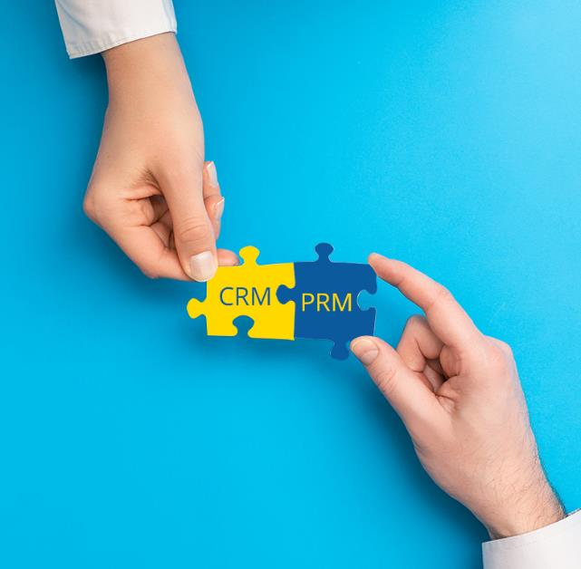
Connecting Your HubSpot CRM to a Partner Relationship Management Platform
As we have noted in various other articles, both PRMs and CRMs are purpose-built, but together they can create the ultimate business solution—sort of like a peanut butter and jelly sandwich. You need marketing and sales as the book ends, but in between you need your CRM to connect to a PRM to create the prefect PBJ sandwich. That’s the only way leads, deals and incentives can flow back and forth between your PRM and CRM. Finally, I would like to point out that in addition to these three core areas—lead management, deal registration and incentives management—there are multiple other ways a partner relationship management (PRM) platform like ZINFI can connect to a CRM like HubSpot. These additional points of integration include business planning, contracts management, learning management, configure-price-quote (CPQ), and more, many of which we have discussed in other articles. But let me emphasize a key point once more: The purpose of a PRM is not to replace a CRM or vice versa. Each application has its own intrinsic purpose and functionality. However, the common intersection points not only make remote, distributed work seamless but increase productivity enormously as data and work flow back and forth at the speed of digital between these two systems, — HubSpot CRM and ZINFI PRM—on a truly integrated business automation platform.

Slide 11
Automating Profitable Growth™

