Slide 1
Automating Profitable Growth™
Partner Relationship Management In a
Post-Pandemic World

Slide 2

Partner Relationship Management In a Post-Pandemic World
Understanding paleolithic art in Lascaux cave paintings requires expertise, experience, imagination and patience. The same qualities are needed to figure out how the world will look once this horrific pandemic is over. We just received the great news that one of the pharmaceutical companies has cracked the code for a COVID vaccine and will be rolling it out in December, reaching the masses early to mid-year 2020. This is incredible news, and most of us cannot wait for the next six months to fast-forward to normality. But what does normal look like? And, when it comes to the business of channel management, what does partner relationship management could really look like when this pandemic is over? But first, let’s take a few minutes to reflect on where we are as mere mortals.

Slide 3

Partner Relationship Management In a Post-Pandemic World
There has been plenty written this year about the future of work, whether people will ever go back to the office, whether travel will ever return to normal, whether we will all move away from cities and, most importantly, how we will spend our leisure time. Many of us have taken the extra time at home to pursue new activities like learning how to bake sourdough bread, finally cleaning the garage, organizing the photo albums or kitchen pantry, having Zoom calls with family members who in normal times we would most likely avoid—but no matter how satisfying some of these projects have been, we all have longed to go back to the way it was. In fact, many have ventured into the risky business of bar-hopping or pubbing and ended up getting infected and sick. There is even a tool now where you can estimate your risk of COVID-19 exposure. We cannot stop trying to go back to something that resembles “normal.”

Slide 4
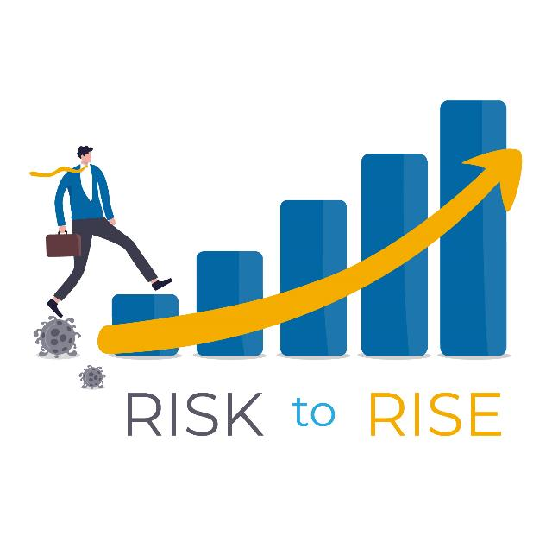
Partner Relationship Management In a Post-Pandemic World
We are social animals, after all. We need to be with our herd or tribe in person, not via some digital cyberspace. A tool like Microsoft Teams or Zoom or WebEx may bring us closer than a simple telephone call, but these tools are no replacement for face-to-face human contact. The intrinsic human need to connect, share, collaborate, create and leave a legacy drove the creation of the Lascaux cave paintings, and even now we leave our legacies through the medium of human connection. Some of it is cognitively driven, but most of it is just pure animal instinct. It’s these instincts that have pushed us out of our homes during the COVID lockdown, even though the risks continue to rise.

Slide 5

Partner Relationship Management In a Post-Pandemic World
So what does this have to do with channel marketing? The most important word in “partner relationship management” is the one in the middle: “relationship.” Relationships don’t really work that well remotely, and research has shown that social tools like Facebook and Instagram can never replace healthy face-to-face social interaction. And I would argue that this need for social interaction is what will get us back to the way we pretty much used to be. “Wait, what?” I hear you asking. “How is that possible? Haven’t we been reading over and over the past six months that COVID would completely change how we work, live, travel, etc.? Haven’t we been hearing that the end of globalization is near?” So why am I suddenly saying not much will change? Well, I say that with certain caveats. There is no doubt in certain domains adoption of technology has accelerated since the pandemic hit. I’m thinking not just about Zoom calls with family members, but also increases in the use of telemedicine, home delivery services and many other forms of remote engagement. However, I think it’s fair to say most of us have also come to the conclusion that none of these activities can replace face-to-face engagement. They augment physical presence, but they don’t really substitute.

Slide 6

Partner Relationship Management In a Post-Pandemic World
So, with this idea of an intrinsic need for in-person connection as context, I propose that the future of partner relationship management is pretty much the same as it was prior to COVID-19. Yes, more companies may accelerate their go-to-market strategy via a channel, and more may rely on remote partner recruitment, onboarding, training, management, etc., but these trends, like telemedicine, were already present. In a post-pandemic world, we will continue to maintain and manage business relationships in person. Yes, it may take until 2022 or later for business travel to get back to the way it was prior to pandemic, and there have been forecasts that it may never recover to pre-pandemic levels, but the reality is we are all getting tired of being on Zoom calls all the time. Some of it is absolutely good, and may remain necessary to manage costs, but it will not replace going to see clients in person or taking a partner out to lunch or conducting partner events on a large scale.

Slide 7
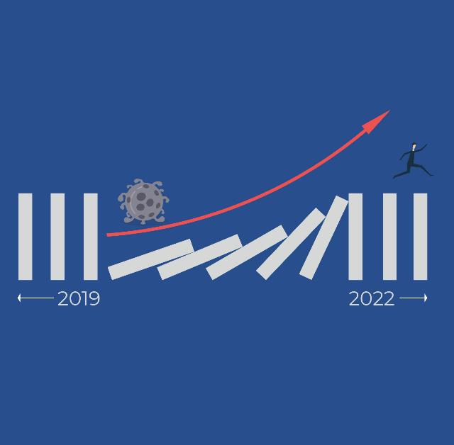
Partner Relationship Management In a Post-Pandemic World
We are all just waiting to get back to normal. Yes, partner relationship management will certainly include many digital tools like what we at ZINFI have been offering for a long time. These tools will augment experiences and make companies more productive, as they already have been doing over the past decade, but they will never replace face-to-face engagement completely. After the dust settles in a post-pandemic world, it’s anyone’s guess what percentage of in-person engagement will be replaced by remote activities, but it is fair to say that most of us will push in every possible way to get back to the way we were. Businesses will always look for ways to cut unnecessary costs, but I am betting that by 2022 we will pretty much be back to the way we were in 2019.

Slide 8
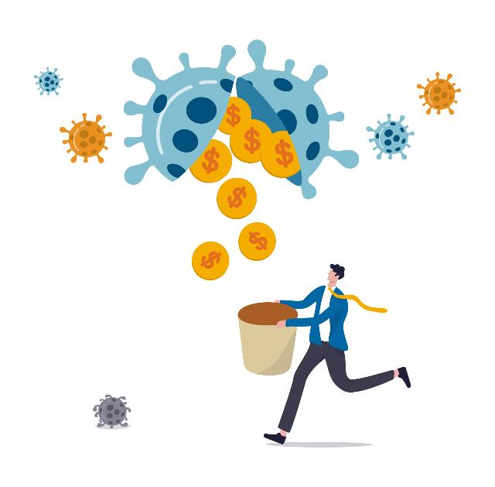
Partner Relationship Management In a Post-Pandemic World
Now, let’s return for a minute to the core elements of partner relationship management that are quite suitable for remote engagement, such as recruiting partners into programs, onboarding partners into various tracks associated with programs, upgrading them from one level to another based on their activities, helping them generate leads and register deals. All of these activities wil continue to get easier—not because of COVID, but because of the innovations that ZINFI and others are bringing to the marketplace. This kind of innovation has been an independent vector of growth, and will continue at its own pace. 2020 and 2021 may help accelerate adoption of some of those tools because they just make logical sense, but partner relationship management will happen in person wherever it made sense prior to COVID, and it will remain digital where it made sense before. Digital will never replace physical completely, but it will absolutely continue to augment in-person interactions by making them more organized, productive, effective and efficient.

Slide 9

Partner Relationship Management In a Post-Pandemic World
I started this article by referring to the Lascaux paintings and suggesting that deciphering them requires human ingenuity—things like expertise, experience, imagination and patience. In fact, during this current crisis we as a species have demonstrated incredible amounts of ingenuity—despite the disregard of safety measures by a few. Even one death is one too many, but the sad silver lining of this pandemic is that it has so far been relatively benign compared to 1918 pandemic, when 50 million people died. The death toll in the current pandemic is likely to be much lower due to containment, treatment and eventual eradication via a vaccine. Over the past year, we have demonstrated at a breakneck speed not only how globalization can spread a horrible virus in weeks across the world, but also how science can help us respond more effectively and how sound economic policy can help us develop financial remedies to stabilize global markets and ensure more jobs are not lost.

Slide 10

Partner Relationship Management In a Post-Pandemic World
In most developed countries, economic recovery has been swift, although it is leaving behind millions of unskilled workers. This is a fundamental social gap in social and government policies that will require expertise, imagination, experience and patience from all to remedy. The trends of rapid urbanization and skill clusters are not going to slow down in the long term. We are not going to leave cities in hordes and move back to villages—quite the opposite. In fact, real estate prices indicate that coastal properties have risen in value during this pandemic due to increases in jobs and skill clustering. The challenges ahead of us are not insurmountable, even though many of them do look highly complex today. Just like the Laxcaux paintings, which brought the tribes together to celebrate life through their own ingenuity, I am confident that the world will come together even more, overcoming forces like nationalism and protectionism to become a better place, because in the end relationships are what matter the most, whether you are talking about partner relationship management, customer relationship management or personal relationship management. We belong together—not apart in some cyberspace!

Slide 11
Automating Profitable Growth™

